Slide 1
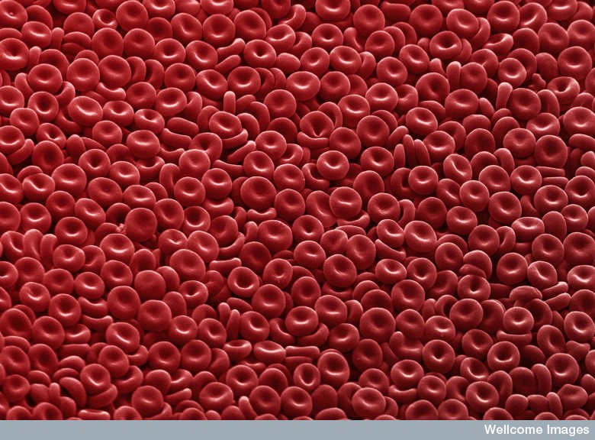
Cell structure & Function

Slide 2
Videos
The Wacky History of Cell Theory
How We Think Complex Cells Evolved
Cell vs. Virus: A Battle for Health
The Operating System of Life
How do Cancer Cells Behave Differently from Healthy Ones?

Slide 3
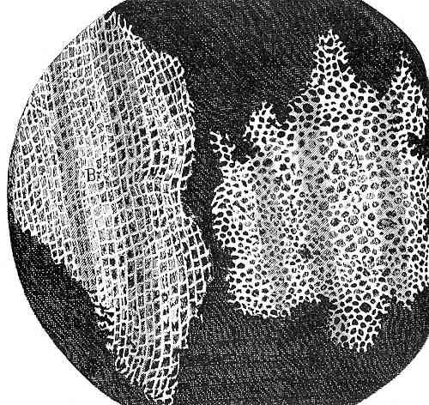
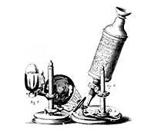
I. Discovery of the Cell
Our knowledge of cells is built on work done with microscopes
  English scientist Robert Hooke in 1665 first described cells from his observations of cork slices. Hooke first used the work “cell”

Slide 4
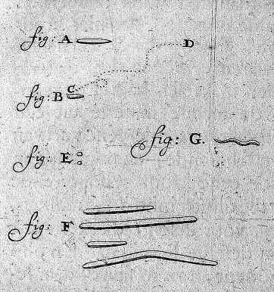
Dutch amateur scientist Antonie van Leeuwenhoek discovered microscopic animals in water
German scientists Schleiden and Schwann in 1830’s were first to say that “all organisms are made of one or more cells.”
German biologist Virchow in 1858 stated that all cells come from the “division of pre-existing cells.”

Slide 5
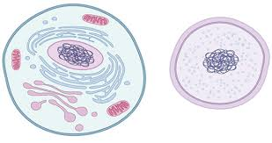
II. Cell Theory
All living organisms are made up of one or more cells
The cell is the basic unit of life
All cells come from the division of pre-existing cells

Slide 6
III. Cells
Living things exist at a cellular or multi-cellular level
Life occurs only in cells…
  Molecules or materials outside of cells are not considered living
  Once they are taken in and become incorporated into cytoplasm or molecules of the cell they are considered living
  Molecules present carry on biochemical reactions in an organized manner
Cells carry on all the processes associated with life, such as reproducing and interacting with the environment

Slide 7
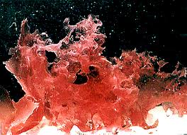
IV. Cell Size
Cells come in many shapes and sizes, although most are microscopic:
  Most cells are small, about 0.001 cm in length (1/100 of a mm or 10 μm)
  Smallest cells are 0.3 μm in size
  Some cells are large
    Giant algal cells may be several centimeters long
    A chicken’s egg is a single cell

Slide 8
40,000 red blood cells would fill the letter “O” on a page of type. You produce about 2.5 million new red blood cells every second!
Each square cm of your skin contains about 150,000 skin cells
Human beings are composed of about 50 to 100 trillion cells
Ted-Ed Electron Micrograph Images

Slide 9
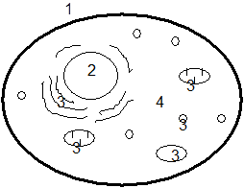
V. Eukaryote Cells
The cell’s overall structure can be viewed as:
  Cell Membrane
  Nucleus
  Organelles
  Cytoplasm

Slide 10
Cell Membrane: the thin layer which separates the cell contents from it’s environment. Plant cells also have cell wall surrounding the cell membrane.
Nucleus: specialized structure within the cell which contains DNA and controls cell functions and reproduction.
Organelles: small bodies with specific structures and functions within the cell.
Cytoplasm: the liquid substance between the nucleus and the cell membrane, in which the organelles are located

Slide 11
VI. Cell Structures and their functions
Endosymbiont Theory
Molecular Happenings in cells

Slide 12
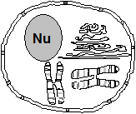
VI. Cell Structures and Functions
Nucleus
  Large, centrally located
  Surrounded by a double layer membrane with pores for selective intake and release of molecules – a nuclear envelope
  Contains:
    Nucleoplasm
    Chromosomes
      Contains DNA and organizer proteins (histones) densely coiled together
      Only visible near the time of cell division, when condensed for “transport”, otherwise it is called chromatin
      Contains all the genetic code for the organism

Slide 13
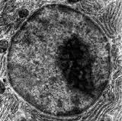
  Nucleolus
    Dark-stained areas in the nucleus (usually spherical)
    Contain genetic material for making a form of RNA called ribosomal RNA (rRNA)
    rRNA travels to the cytoplasm, where it forms the subunits of the ribosomes
Function: Transcription (read) and replication (duplicating) of the genetic code occurs here

Slide 14
Ribosomes
Small dense-staining granules
Composed of rRNA and some proteins that are joined prior to migration to the ER
Found on surface of ER (for producing proteins to be exported out of the cell)
Also found free-floating in cytoplasm in small groups called poly(ribo)somes
  Polysomes produce proteins to be used inside the cell
Function: Involved in protein synthesis (ensure correct amino acids and make peptide bonds)

Slide 15
Endoplasmic Reticulum
Animation

Slide 16
Rough ER (Endoplasmic Reticulum)
Series of tubular canals connected to places with nuclear membrane
Covered with ribosomes
  Ribosomes produce proteins to be exported out of cell
  Proteins move inside the lumen of the ER then on to the Golgi apparatus
Function: Produce/modifies proteins to be exported by the cell

Slide 17
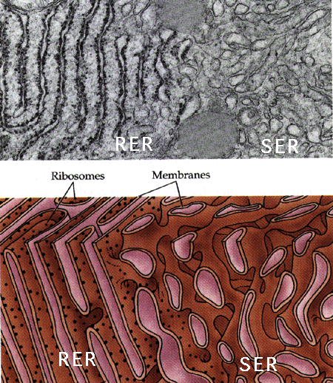
Smooth ER
Similar in structure to rough ER except no ribosomes on surface
Associated with lipid and steroid production [abundant in organs that produce steroid hormones (ovaries, testes, adrenal cortex)]

Slide 18
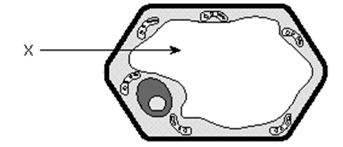
Vacuoles
Non-living, and much larger in plant cells
Membrane-covered sack usually filled with water and waste chemicals
Small vacuoles are called vesicles

Slide 19
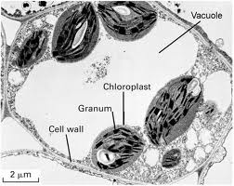
Function in plant cells:
  Have one large central vacuole that may occupy 90% of the cell volume
  Give rigidity to the cell “pressurized”
  Make the cytoplasm into a thin layer against the cell membrane to allow for better gas exchange
  Storage of waste products of metabolism

Slide 20
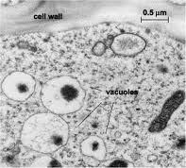
Function in animal cells:
  Digestion of food (ex. Food vacuoles in Amoeba)
  Elimination of excess water (ex. Contractile vacuole in Paramecium)

Slide 21
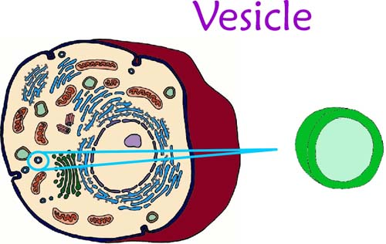
Vesicle
A small vacuole
Often used to move certain compounds require separation from the cytoplasm
ex. “bleb” off the Golgi, or are formed by infoldings of cell membrane

Slide 22
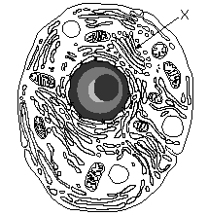
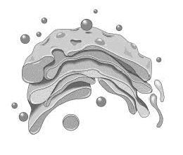
Golgi Body (Golgi Apparatus)
Looks like a series of flattened pancakes
Materials which are produced elsewhere in the cell (esp. ER) are temporarily stored here
Materials are packaged into vesicles which pinch off from the edges
  These vesicles are distributed within the cell or are shipped to the cell membrane for excretion

Slide 23
Lysosomes
Membrane-covered vesicles of hydrolytic enzymes which move throughout the cell
Produced by the Golgi
Functions:
  Attach to food vacuoles and digest contents
  Destroy old or malfunctioning cell parts
  Destroy the cell itself if the cell becomes damaged or malfunctions

Slide 24

Mitochondria
cristae
Double membraned structure where the inner membrane is highly infolded into cristae to increase inner surface area
  Cristae: where enzymes are arranged in order to carry out certain reactions
matrix

Slide 25
Found in both plant and animal cells
Have own DNA (endosymbiont hypothesis)
Function:
  Convert food energy to a form of energy which can be used by the cell (this energy is in the form of ATP: adenosine triphosphate)
  Process: Cellular respiration
    Glucose + O₂ → CO₂ + H₂O + ATP energy
  The more active a cell, the more mitochondria it will have (ex. Muscle & Sperm cells)
  Clip: powering the cell

Slide 26
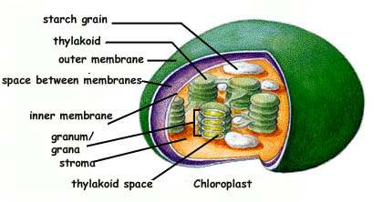
Plastids (chloroplast)
Found only in plant cells
3 types of plastids:
  Chloroplasts – more common
  Structure
    Have “coin-like” membrane sacks (thylakoids) arranged in “stacks” called grana that are joined together by lameliae (membranes between sacks)
    The inner portion of the chloroplast is called the stoma

Slide 27
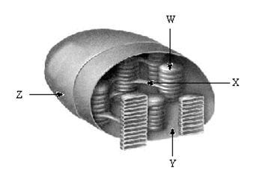
Contain chlorophyll (in grana)
  Site of photosynthesis
  H₂O + CO₂ → sugar + O₂

Slide 28
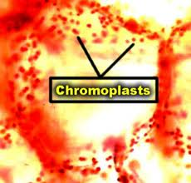
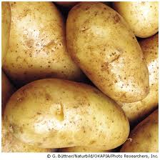
  Chromoplasts
    Stores pigment other than chorophyll (ex. Carotene, xanthophylls that make carrots, peaches, autumn leaves, etc. yellow and orange)
  Leucoplast
  Stores starch (ex. In potatoes)

Slide 29
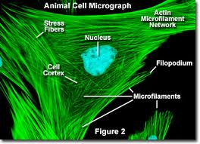
Microfilaments
Thin solid fibers of protein – similar to proteins in muscle fiber
Provide skeletal framework for the cell (cytoskeleton)

Slide 30
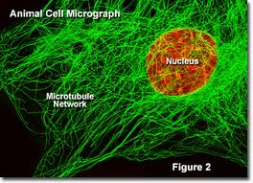
Microtubules
Larger than microfilaments
Proteins called tubulin are coiled in a cylindrical fashion (think slinky) around a central lumen
Found in cilia, flagella and centrioles
Provide skeletal framework for the cell (cytoskeleton)

Slide 31
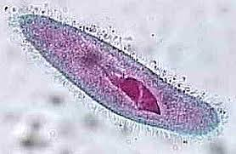
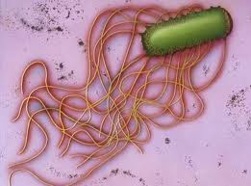
Cilia and Flagella
Hair-like projections of the cell
  Cilia – short and many
  Flagella – long and few
Composed of protein fibres that are able to contract and cause the cilia or flagella to beat or wave back and forth
For cell locomotion, or generating current

Slide 32
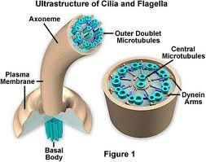
Inside (cross-section):
  A “9 + 2” arrangement of microtubules
  Except: in their basal body (anchor in cytoplasm) where the two central tubules are gone (a “9 + 0” pattern)

Slide 33
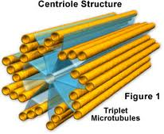
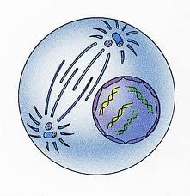
Centrioles
Are short cylinders with a “9+0” pattern
Produce the basal bodies of cilia and flagella
Probably involved in some way with the formation of spindle fibres in the mitotic process
Usually 2 centrioles lie on either side of the nucleus (during times of nuclear division)
Found in all animal cells

Slide 34
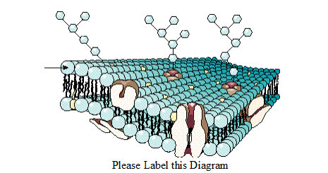
Cell Membrane
The cell membrane functions in transport of materials in and out of cell, recognition, communication and homeostasis

Slide 35
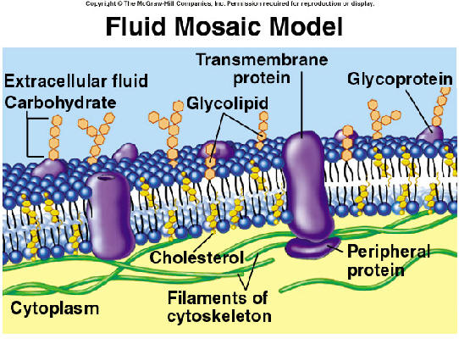
2. The Fluid Mosaic Model
Cells are surrounded by a thin membrane of lipid and protein, about 100 angstroms (100 x 10⁻¹⁰ m) thick.
The cell membrane is a remarkable structure that has properties of a solid and a liquid
It forms a “fluid sea” in which proteins and other molecules like other lipids or carbohydrates are suspended (like icebergs) or anchored at various points on its surface.

Slide 36
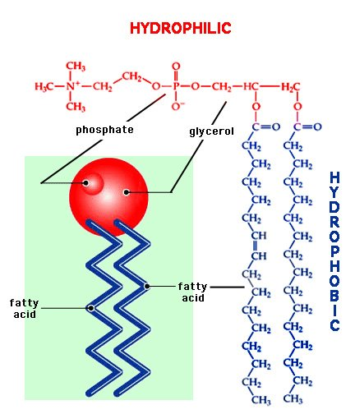
The “sea” or “fluid” part is composed of side by side phospholipids arranged in a bilayer (called a lipid bilayer)
The solid part (the “mosaic”) is the variety of proteins etc. embeded in the bilayer.
Each phospholipid has a hydrophobic tail and a hydrophylic head

Slide 37
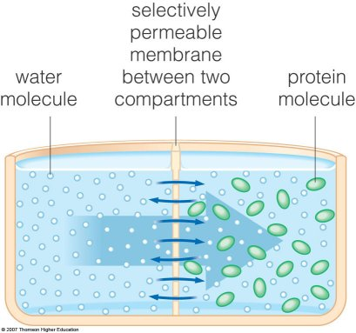
The membrane has consistency of light machine oil.
The membrane is selectively permeable (will let some substances in but not others of the same size)

Slide 38
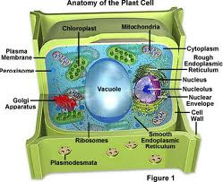
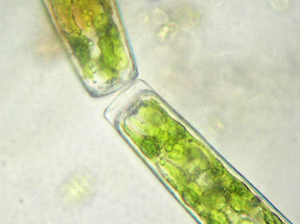
Cell Wall
Only in plant cells
Made of cellulose (sugars linked with a strong bond)
Very rigid (but porous) and difficult for animals to digest (think “wood”)
Small molecules have little difficulty penetrating the cell wall, while larger molecules may not be able to pass through. (The cell wall is said to be semi-permeable)

Slide 39
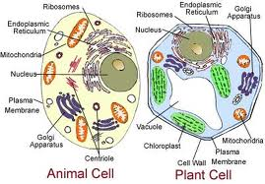
VII. Plant Cell vs. Animal Cell
Plant cells have:
  A cell wall
  Plastids
  A large central vacuole…animal cells do not!
Animal cells have
  Centrioles…plant cells do not!

Slide 40
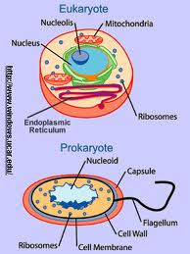
VIII. Prokaryotes vs. Eukaryotes
Two classes of cells exist: the prokaryotes and the eukaryotes
The prokaryotes include the bacteria and the blue-green algae (the Monera kingdom)
  These are all single-celled organisms that lack both a true nucleus and other membrane-bound cellular substructures
  Prokaryotic DNA is usually circular

Slide 41
The Eukaryotes include plants, animals, protozoa and fungi
  These cells contain nuclei and other membrane-bound organelles
  The genetic material is organized into chromosomes
 |  | Eukaryotic
Structure | Prokaryotic | Animal | Plant
Cell Membrane | YES | YES | YES
Cell Wall | YES | NO | YES
Nucleus | NO | YES | YES
Mitochondria | NO | YES | YES
Chloroplasts | NO | NO | YES
ER | NO | YES | YES
Ribosomes | YES, small | YES, large | YES, large
Vacuoles | NO | YES, small | YES
Lysosomes | NO | YES, usually | NO, usually
Cytoskeleton | NO | YES | YES
Centrioles | NO | YES | NO

Slide 42
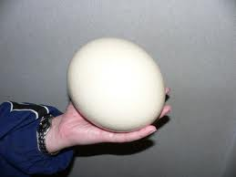
Surface Area to Volume Ratio & Cell size
Why aren’t cells bigger?
Cell
  Contains many structures and are highly organized
  May be thousands of each organelles in any given cell
  Smallest cell: a pleuro-pnemonia like organism with a diameter of about 0.1 μm
  Largest cell: an ostrich egg
Cell Size Animation

Slide 43
II. Ratio of Cell Surface Area to Cell Volume
Animation
As the size of a cell increases, its surface to volume ratio decreases
A cell measures 1 mm³. Its surface to volume ratio is 6:1
  Surface area (for a square): area of one face x 6
  ex. SA = 1 mm x 1 mm x 6 = 6 mm²
  Volume: length x width x height
  ex. V = 1mm x 1 mm x 1 mm = 1 mm³

Slide 44
If you double the size of the cell is 2 mm across, its surface to volume ratio decreases to 24:8 or 3:1
  SA = 2 mm x 2 mm x 6 = 24 mm²
  V = 2 mm x 2 mm x 2 mm = 8 mm³
  When the size doubled, the SA:V ratio decreased by half!

Slide 45
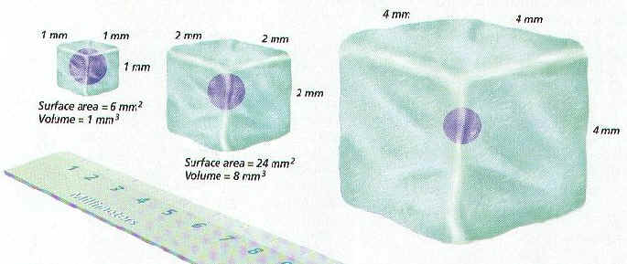
Example:
Cell Size | Surface area | Volume | SA:V Ratio
1 X 1 | 6 | 1 | 6:1
2 X 2 | 24 | 8 | 3:1
4 X 4 | 96 | 64 | 1.5:1
8 X 8 | 384 | 512 | 0.75:1

Slide 46
Example
Volume of Sphere = Surface Area of Sphere = 4πr²
Sphere | Radius (cm) | Volume (cm³) | Surface Area (cm²) | SA:V Ratio
1 | 1 | 4.1 | 12.6 | 3:1
2 | 2 | 33.5 | 50.3 | 1.5:1
3 | 3 | 113.1 | 113.1 | 1:1

Slide 47
III. Limitations of Cell Size
When cells get too large, they must divide
Cells cannot get too large because of the way that a cell’s volume changes with respect to its cell surface area
As the cell increases in volume the surface area must also increase in order for the cell to take in or get rid of materials (nutrients in: waste out)

Slide 48
Diffusion is not a highly rapid or efficient means of distributing materials over long cellular distances, so no portion of even the largest active cells is more than 1 mm from the cell membrane
If the surface area is small relative to volume, the cell may build up waste to such an extent that the cell may die

Slide 49
IV. Solving the Limits of SA to V Ratio
Cells can divide by mitosis
Slow down metabolism
  If a cell metabolizes (carries on its cellular activities) at a slow rate it will produce wastes at a slow rate and need fewer nutrients than a cell that metabolizes at a fast rate
  A slowly metabolizing cell could then be larger than a quickly metabolizing cell

Slide 50
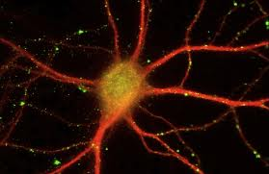
Cell Shape
  Shape of the cell can affect the surface area of the cell
  Spherical cell has the smallest surface area to volume ratio
  Long or thin or flat cell has a much higher surface area to volume ratio
    Get ling and thing round and fat. Ex. Nerve cells

Slide 51
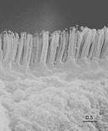
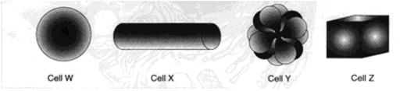
  Folds in the cell membrane:
    ex. Microvilli of intestinal epithelial cells
  Which cell has the most surface area if all 4 cells have the same volume?
Notes:
Cell Y

