Slide 1
Human Physiology
Biology 12
Notes:
Ameoba Sisters
https://www.youtube.com/watch?v=gEUu-A2wfSE

Slide 2
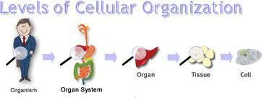
I. Human Organization
Human body has several levels of organization:
Cells of the same type joined together are called tissues
Different tissues are joined together to form organs
Various organs are arranged into an organ system

Slide 3
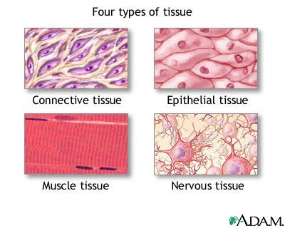
II. Tissues

Slide 4
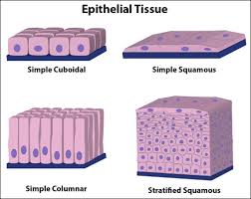
A. Epithelial
Covers body, lines cavities
Covers entire body surface and most of the body’s inner cavities.

Slide 5
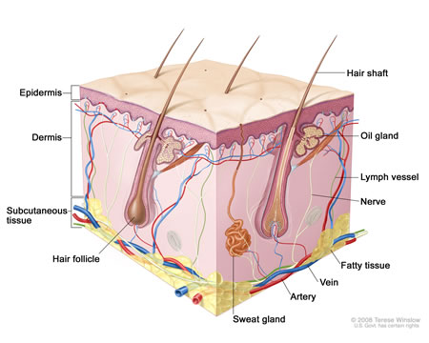
Outer epidermis (skin) protects from injury and drying out
Inner epidermal tissue protects and secretes mucus (ex. Along digestive tract)

Slide 6
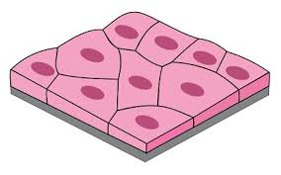
5. Types
Squamous Epithelium
Function in protection, diffusion, filtration
Made of flat cells
Ex. Lines alveoli and walls of capillaries, blood vessles

Slide 7
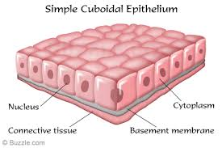
Cuboid Epithelium
Function in secretion, absorption and protection
Cube shaped cells
ex. Line kidney tubules, surface of ovaries

Slide 8
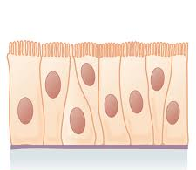
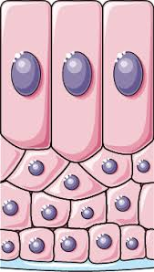
Columnar Epithelium
Column-shaped cells
Often have microvilli or cilia to aid function
Ex. Lining of intestine, oviduct lining, lining of uterus
Each type can exist as a single layer or be stratified (layers stacked on top of each other)
Ex. mouth, nose, vagina lined by stratified squamous epithelium.

Slide 9
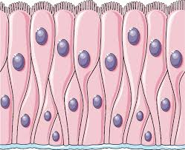
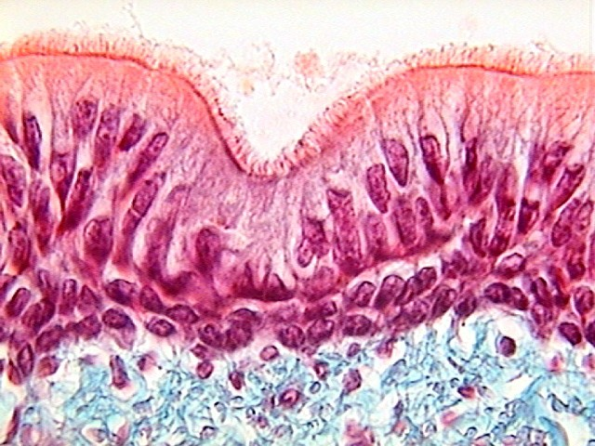
Pseudostratified Columnar
Appear to be layered but is really just one layer of cells
Ex. Lining of respiratory tract

Slide 10
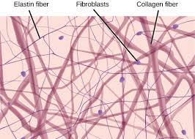
B. Connective
Functions:
Binds structures together
Fill up spaces
Provide support and protection
Stores fat
Structure:
Cells in connective tissue usually in matrix usually made of either collagen or elastin

Slide 11
3. Types
Loose
Join tissues, hold organs in place, fat storage
Fibrous
Bundles of collagen fibers, very strong
Used in tendons (connect muscle to bone) and ligaments (connect bones to other joints)

Slide 12
Cartilage
Flexible matrix rich in protein and fibers
Ex. Nose, ears, vertebrae, ends of bones
Bone (Ted-Ed Bone)
Rigid connective tissue
Matrix of calcium salts
Blood
Matrix is liquid called plasma
Notes:
http://ed.ted.com/lessons/how-to-grow-a-bone-nina-tandon

Slide 13
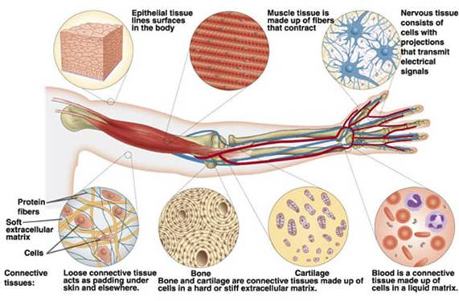

Slide 14
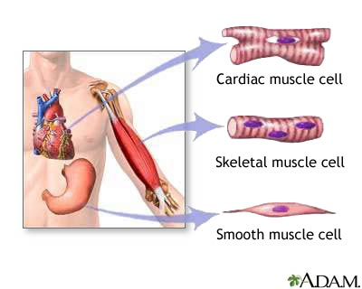
C. Muscle Tissue (Ted-Ed Muscle)
Contracts for movement
Composed of fibers made of actin and myosin proteins whose interaction is responsible for movement
Notes:
https://ed.ted.com/lessons/how-your-muscular-system-works-emma-bryce

Slide 15
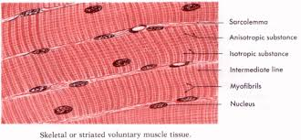
3. Types
Skeletal Muscle
Striated (alternating light and dark bands)
Attached to bones and used for movement
Voluntary control
Can contract quickly and strongly but will fatigue in time

Slide 16
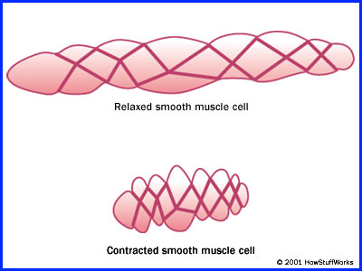
Smooth Muscle
Non-Striated
Involuntary control
Found in walls of internal organs (intestine, stomach, blood vessels)
Contracts more slowly, but can contract over a longer period of time.

Slide 17
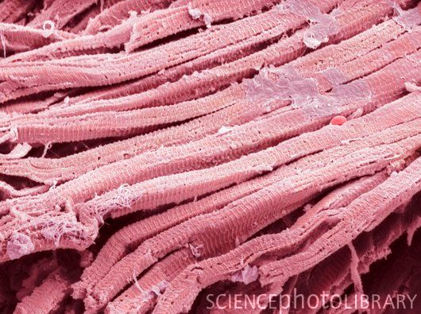
Cardiac Muscle
Striated
Involuntary
Forms heart muscle
Found only in the heart
Can contract quickly, and beats your whole life through

Slide 18
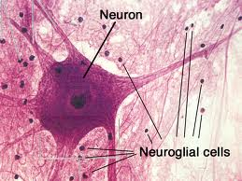
D. Nervous Tissue
Respond to stimuli and transmits impulses from one body part to another.

Slide 19
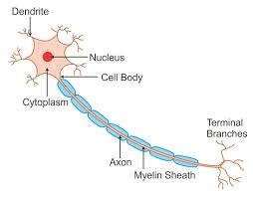
Conduct electrical and chemical messages along special cells called neurons
Composted of:
Cell body
Dendrites: conduct messages to cell body
Axon: send messages away from cell body
Axon and dendrites are nerve fibers
Bindles of nerve fibers are called nerves

Slide 20
Nerves conduct messages to and from spinal cord, brain, and sense organs to register sensation and trigger muscle movement
Glial cells surround nerve cells
Help to support, protect, and nourish nerve cells
Provide nutrients to the neurons and help keep the tissue free of debris

Slide 21
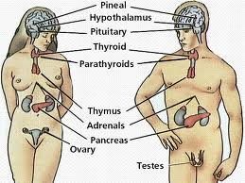
E. Glands
A single cell or a collection of cells that secrete something

Slide 22
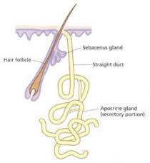
2. Types
Exocrine glands
Secrete into ducts
Ex. Gall bladder is an exocrine gland because it secretes bile in a duct
Ex. Sweat glands are exocrine glands

Slide 23
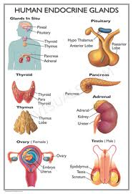
Endocrine glands
Secrete chemicals (especially hormones) into bloodstream
Ex. Pancreas secretes insulin into the blood

Slide 24
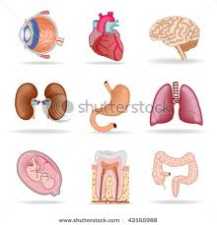
III. Organs

Slide 25
Tissues working together
Organs are made up of one or more types of tissues (usually more)
Each located in specific location, with specific functions

Slide 26
D. Human Organ Systems overviews
Digestive | convert food to usable nutrients
Circulatory | transport of necessary molecules to cells
Immune | defense against invading pathogens
Respiratory | gas exchange
Excretory | gets rid of metabolic wastes

Slide 27
D. Human Organ Systems overviews
Nervous & Sensory | regulation and control, response to stimuli, processing information
Muscular & Skeletal | support and movement
Hormonal | regulation of internal environment, development
Reproductive | producing offspring

Slide 28
Many internal organ systems enclosed within coelom, cavity within the body
Organ systems contribute to maintaining a stable internal environment (homeostasis)
Ex. Temperature, pH, [glucose], blood pressure

Slide 29
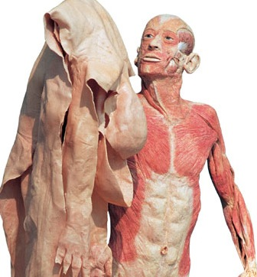
IV. Skin
An example of an organ
Video
Notes:
http://www.youtube.com/watch?v=fXIcwm1oqQw

Slide 30
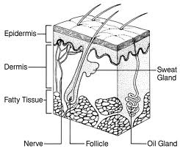
Largest organ and has several tissue layers
Skin covers body surfaces, gives protection from water loss and invasion by microorganisms, contains sense organs, help to regulate body temperature

Slide 31
Skin is made up of three layers
Epidermis
Outer layer
Composed of stratified squamous epithelial cells
Basal cells at base of this layer produce new cells
Pigment cells (melanocytes) here produce melanin, responsible for skin color
Keratin protein hardens skin cells. (Hair & nails are made of tightly packed keratinized cells)

Slide 32
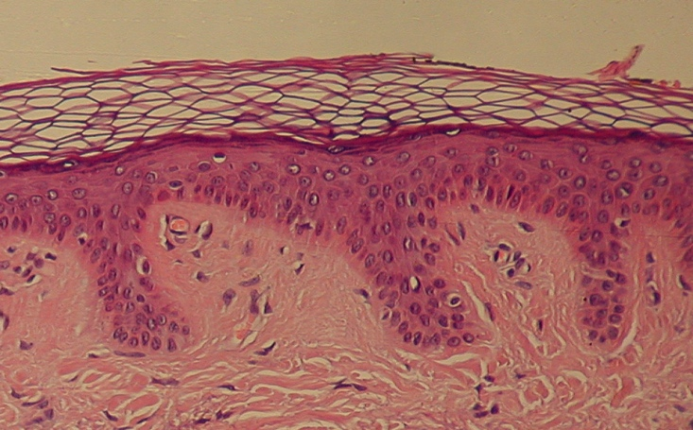
Dermis
Middle layer
Loose connective tissue with many elastic fibers
Sweat glands, nerve endings, blood vessels, and hair follicles located here

Slide 33
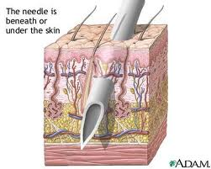
Subcutaneous Layer
Bottom Layer
Loose connective tissue containing adipose cells (fat)

