Slide 1
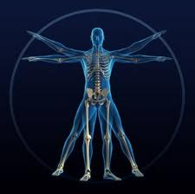
Biology 12
An Introduction

Slide 2
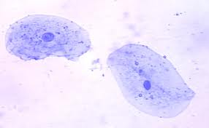
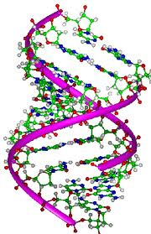
Biology is the STUDY OF LIFE
All living things:
Are made up of cells
Grow and maintain structure by taking in chemicals and energy from their environment
Respond to the external environment
Reproduce and pass on their organization (genetic information) to their offspring
At the species level, evolve/change and adapt to the environment

Slide 3
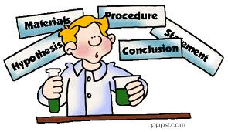
Biologists use the Scientific Method
We:
  ask questions
  observe the world
  formulate hypotheses
  test them in controlled experiments
  revise
  make conclusions

Slide 4
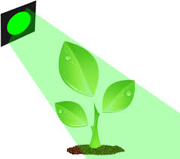
Hypothesis
This is a tentative explanation of what you’ve observed
  e.g. “AIDS is caused by a retrovirus”
Used to decide the type of experiment needed to test hypotheses.
A hypothesis can be wrong!
A hypothesis can be used to propose a logical experiment.
  For example: “If green light is the best light for growing tomato plants, then tomatoes grown under green light will be heavier than tomatoes grown under red or blue light.

Slide 5
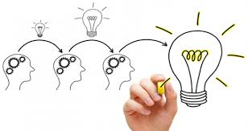
Theory
Widely accepted, successful, tested hypothesis accepted around the world.
By the time a hypotheses becomes a theory, scientists have the utmost confidence in it.
e.g. Theory of General Relativity

Slide 6
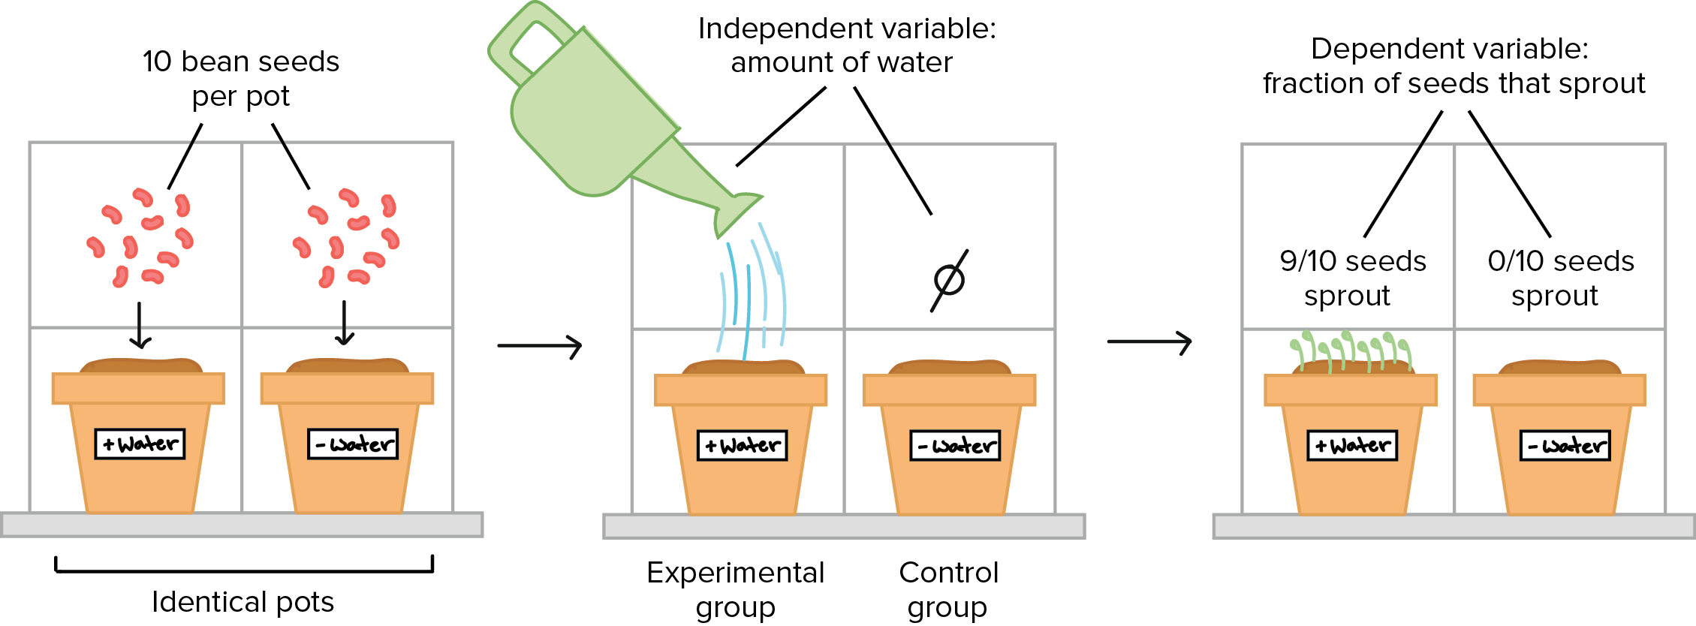
Experimental “CONTROL”
A control is a sample that undergoes all the same steps in the experiment except the one being tested.
  Necessary in order to eliminate other effects that might influence the outcome of the experiment
  Necessary so that scientists may establish a cause and effect relationship.
    want to eliminate, for example, the "placebo effect.
    Important for testing new medicines

Slide 7
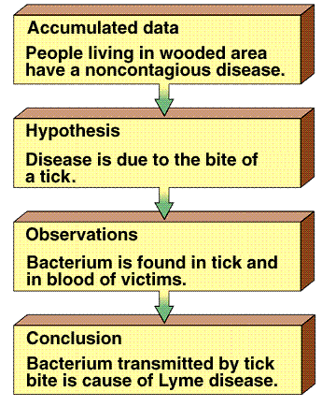
Scientific Method Animation
Notes:
http://www.sumanasinc.com/webcontent/animations/content/scientificmethod.html

Slide 8
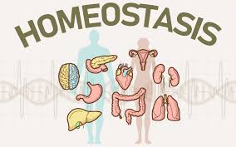
Homeostasis Animation
Notes:
https://www.youtube.com/watch?v=62e8IV-WT8c

Slide 9
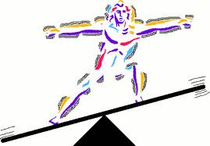
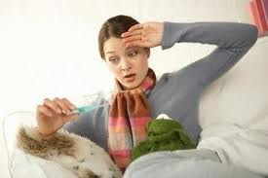
Homeostasis
(The most important word in Biology 12!)
All the things living organisms do that cause it to maintain a relatively constant, stable internal environment regardless of the external environment.
There are countless examples in the human body:
  Ex. If we are cold we shiver to make heat

Slide 10
Homeostasis
blood pH =7.4 | body temp. = 37°C
blood pressure = 120/80 | blood [glucose] = 0.1%
Our bodies work hard to keep these conditions stable in our body

Slide 11
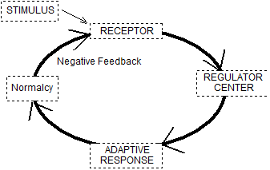
Homeostasis – How does it work?
How is homeostasis controlled?
  It relies on a feedback mechanism
Negative Feedback

Slide 12
Brain control centers ( e.g. the hypothalamus) monitor and control body conditions (e.g. pH, temperature, blood pressure glucose levels)
Sensors all over body detect unacceptable levels and signal the appropriate brain center (e.g. temperature sensors in skin stimulate brain if skin gets colder than 37°C).

Slide 13
Control center directs body to behave in such a way that normal state is regained (e.g. shivering). This is called an adaptive response.
Once normal state is regained, the sensor stops signaling the brain center (this the “negative feedback part”), so adaptive response stops.

Slide 14
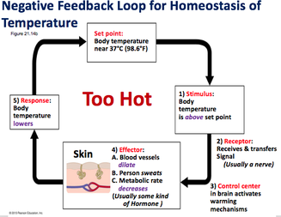

Slide 15
This results in a FLUCTUATION between two levels
e.g. the concentration of glucose in your blood is almost never exactly 0.1%.
  It’s usually a little bit above or a little bit below.
Over the course of a day, though, it would average out to be exactly 0.1%.

Slide 16
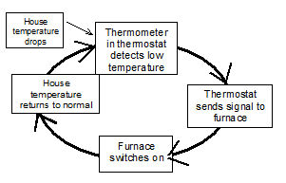
Let’s look at a classic example of negative feedback: temperature control in your house

Slide 17
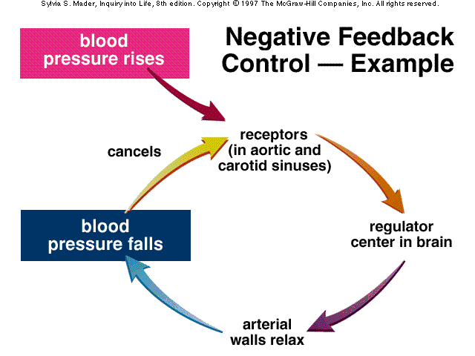
Let’s look at a few examples from our bodies

Slide 18
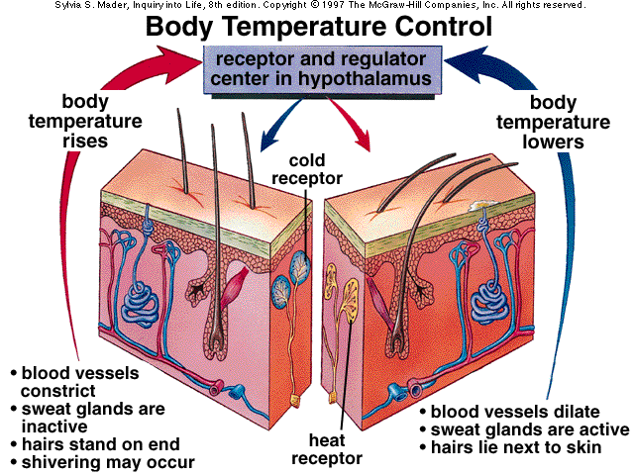
So it is negative feedback that keeps things constant in your body. There are thousands of these negative feedback cycles known. So what then is positive feedback?

Slide 19
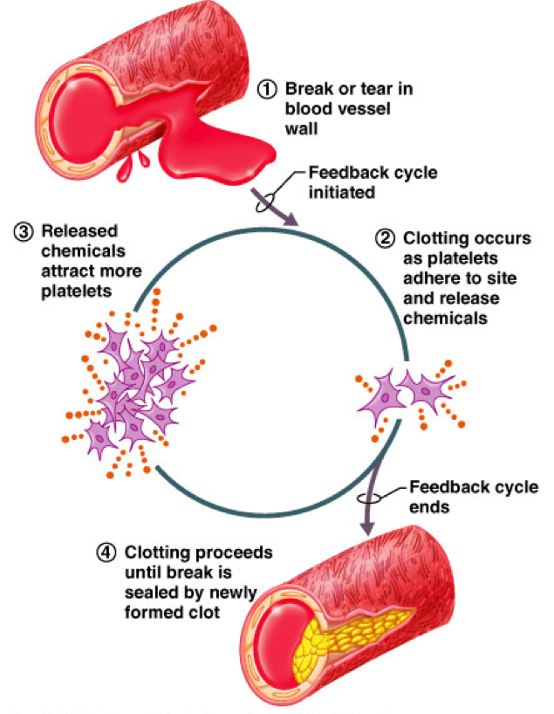
Positive Feedback
POSITIVE FEEDBACK has a number of things in common with negative feedback, such also as requiring receptors and regulatory centers.
However, in positive feedback, the stimulus does not bring about an adaptive response that cancels the stimulus.
Instead, it causes the stimulus to be increased.

Slide 20
This in turn causes a greater adaptive response, which in turn causes a greater stimulus, and so on.
Obviously, this can’t go on forever.
A positive feedback cycle usually ends up in something being ejected from the body.
Because of its nature, positive feedback has a much more limited range of usefulness than negative feedback

Slide 21
Positive Feedback
Regulator Center
Greater Adaptive Response
Stimulus increases
Receptor
Stimulus

Slide 22
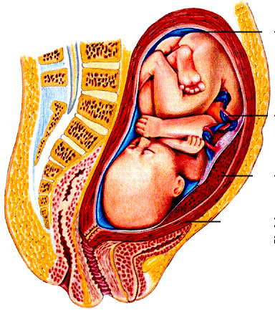
An Example from our body*
Positive feedback loop that occurs during LABOUR (childbirth) involving the hormone oxytocin.
Oxytocin is made in the hypothalamus and stored in the posterior pituitary. It causes the uterus to contract.
Notes:
Need to know

Slide 23
Baby pushing on cervix
Just before birth, the growing baby's head exerts pressure against the cervix.
This pressure triggers sensory nerves in the cervix to send a nerve signal to the posterior pituitary to release oxytocin.
The oxytocin is released into the blood.
Oxytocin into blood
Stronger Uterine Contractions
Greater Stimulation of Sensory nerves
Nerve signals to posterior pituitary

Slide 24
Baby pushing on cervix
When it gets to the uterus, it causes stronger uterine contractions, which causes greater stimulation of the sensory nerves, which causes more oxytocin to be released, which causes stronger uterine contractions, and so on.
The cycle ends when the baby is pushed out of the uterus, stopping the stimulation of sensory nerves to the pituitary.
Oxytocin into blood
Stronger Uterine Contractions
Greater Stimulation of Sensory nerves
Nerve signals to posterior pituitary

Slide 25
Snickers Ads
Snickers Ad Mr. Bean
Notes:
https://www.youtube.com/watch?v=18ya0-OZ58s
https://www.youtube.com/watch?v=qIVDxL2lgN4

