Slide 1
Living vs. Non-living
Biology 11

Slide 2
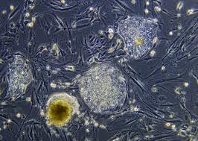
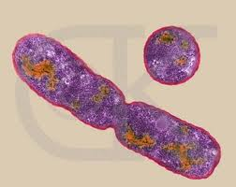
Characteristics of Living Things
A. Are made of one or more cells
B. Reproduce

Slide 3
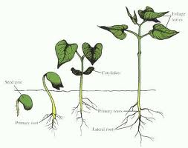
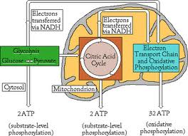
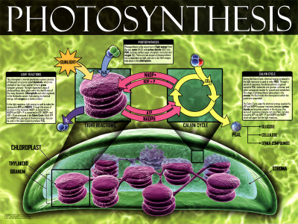
C. Grow and Develop
D. Obtain and use energy

Slide 4
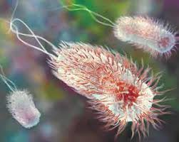
E. Respond to their environment
Motile bacteria can respond by swimming toward or away from a chemical gradient

Slide 5
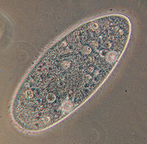
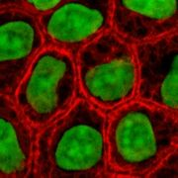
Living things are made up of cells
Cell: a collection of living matter enclosed by a barrier that separates the cell from its surroundings
Unicellular: organisms of only one cell
Multicellular: organisms made up of many cells… hundreds to trillions

Slide 6
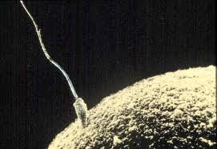
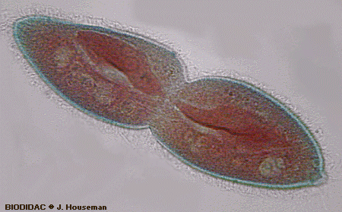
Living Things Reproduce
Reproduction is necessary because all individuals die eventually
Sexual reproduction: two cells from different organisms unite to form the first cell of a new organism
Asexual reproduction: when a single organisms reproduces alone ( eg: unicellular organism dividing in two)

Slide 7
Living Things Grow and Develop
All organisms all capable of growth at one stage or another in their lives
Development (def’n): cycle of change
Eg. The development process by which humans change from children to adults is puberty

Slide 8
Living Things Obtain and Use Energy
Living things obtain energy from their environment for:
Growth
Development
Reproduction
Anabolism: process of synthesizing complex substances from simpler ones (eg. photosynthesis)
Catabolism: breakdown of complex substances to simpler ones. Usually the purpose is to release energy (eg. digestion and cellular respiration)
Metabolism: the balance (sum total) of these processes

Slide 9
Living things respond to their environment
Stimulus: anything in the environment that causes and organism to respond
Examples include: light, temperature, odor, sound, gravity, heat, water, pressure
Homeostasis is a process by which organisms respond to stimuli in ways to keep bad conditions suitable for life
Example (humans): our “thermostat” which regulates the body temperature – too hot we sweat and cool down.

Slide 10
Biology: The Study of Life
To translate the term biology:
Bio = “life”
Logy= “study of”
Biology: a science that seeks to understand / explain / control the living world
Biologist: a person who uses the scientific method to study living things

Slide 11
Branches of Biology
Complete the table using the text examples given:
What “goal” do all biologists have in common?
Level of question/focus | Type of Biologist | Might study:
Questions at the molecular level:
Questions at the cellular level:
Questions at the multicellular level:
Questions at the population level:
Questions at the global level:

