Slide 1
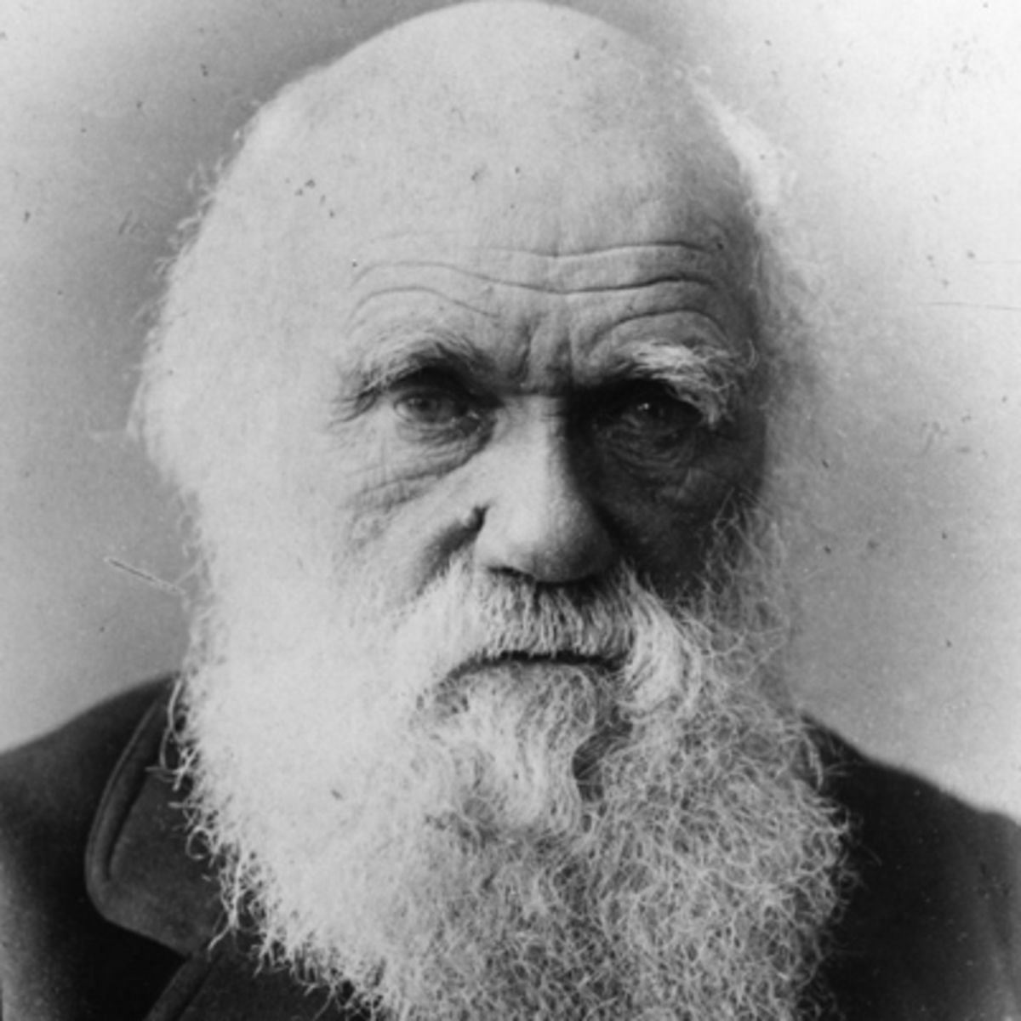
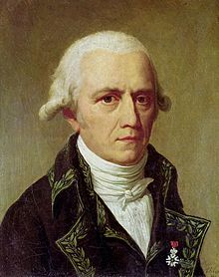
Darwin vs Lamarck
Who thought of this – Lamarck, Darwin or both of them?
Grab a mini whiteboard and whiteboard marker

Slide 2
Who thought of this – Lamarck, Darwin or both of them?
Organisms have changed over time
Both

Slide 3
Who thought of this – Lamarck, Darwin or both of them?
Organisms changed because they wanted to survive.
Lamarck

Slide 4
Who thought of this – Lamarck, Darwin or both of them?
There was variation in a population.
Darwin

Slide 5
Who thought of this – Lamarck, Darwin or both of them?
Certain traits helped organisms survive and reproduce better than other organisms without those traits.
Darwin

Slide 6
Who thought of this – Lamarck, Darwin or both of them?
Organisms can never become extinct
Lamarck

Slide 7
Who thought of this – Lamarck, Darwin or both of them?
The environment had something to do with why organisms changed.
Both

Slide 8
Who thought of this – Lamarck, Darwin or both of them?
Parents are able to pass on at least some of their traits to their offspring
Both

Slide 9
Who thought of this – Lamarck, Darwin or both of them?
Parents are only able to pass on traits that they were born with
Darwin

Slide 10
Who thought of this – Lamarck, Darwin or both of them?
Organisms could decide to change something about their body and pass on that change to their offspring.
Lamarck

Slide 11
Who thought of this – Lamarck, Darwin or both of them?
Organisms are still changing
Both

