Slide 1
The Circulatory System
Anatomy & Physiology 12

Slide 2
Heart Beat co-ordination
Characteristics of Cardiac Cells
Heart muscle tissue can contract on its own
Each cardiac cell can contract independently
Will co-ordinate their contractions if the cells are touching
Video Clip – Dissection – Frog Heart Beating outside body
Notes:
http://www.youtube.com/watch?v=7ZKKy6KCapQ

Slide 3
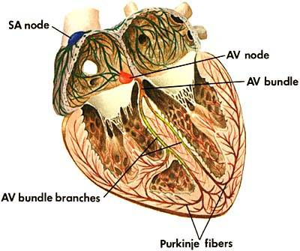
II. Heart nervous tissue
Heart contains nodal tissue, which has characteristics of both nerve and muscle tissue to ensure rapid and coordinated heart contractions
Sinoatrial (SA) node
Located in the upper back wall of the right atrium

Slide 4
The SA node initiates the heartbeat by sending out a signal automatically about every 0.85 seconds to make the atria contract
Called the “pacemaker” because it keeps the beat regular
An implanted artificial pacemaker can send out an electrical signal every 0.85 seconds to stabilize the heart rate if the SA node doesn’t work

Slide 5
Atrioventricular (AV) nodes
Located in the base of the right atrium near the septum
Branches from the SA node are spread over the atria and also to the AV node
When the pulse sent out by the SA node reaches the AV node, the node sends out a signal along special conducting fibers called AV bundle (atrioventricular bundle) down the septum to the Purkinje fibres that spread through the ventricles

Slide 6
Purkinje fibers stimulate cardiac muscle at the base of the heart ventricles and moves up like a wave to cause the ventricles to contract

Slide 7
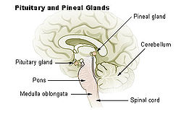
III. Control by the brain
Nervous control controls the heart rate
Controlled in a part of the brain called the medulla oblangata

Slide 8
The medulla sends messages via the autonomic nervous system
Sympathetic nerve branches tells the heart to ”speed up!”
Parasympathetic nerve branches tells the heart to “slow down!”
Various factors such as stress, oxygen levels and blood pressure determine how the autonomic system will affect heart rate

Slide 9
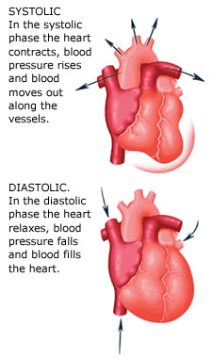
Systolic & Diastolic pressures
Systole & Diastole
Systole = Contraction of heart muscle
Diastole = Relaxation of heart muscle
Ted-Ed Blood Pressure Animation
Notes:
http://ed.ted.com/lessons/how-blood-pressure-works-wilfred-manzano

Slide 10
II. The cardiac cycle
Occurs about 70 times per minute
Each heartbeat can be divided as follows
Time (duration) | Atria are in… | Ventricles are in…
0.15 sec | Systole | Diastole
0.30 sec | Diastole | Systole
0.40 sec | Diastole | Diastole

Slide 11
Each contraction will force 70 mL of blood to be circulated
Results in a total blood volume pumped per minute of ≈ 5L
Entire body’s blood volume is circulated each minute
Pulse is the alternate expanding and recoiling of an arterial wall that can be felt in any artery that runs near the surface of the body (Animation)
Radial artery in wrist, carotid artery in neck are common places to check
Pulse rate indicates the rate of heartbeat
Notes:
http://www.bbc.co.uk/schools/gcsebitesize/pe/appliedanatomy/circulatory/0_anatomy_circulatorysys_act.shtml

Slide 12
III. Blood pressure
Pressure of the blood against the wall of a blood vessel
Created by the pumping action of the heart
When the heart contracts, the blood is forced into the arteries under a great deal of pressure

Slide 13
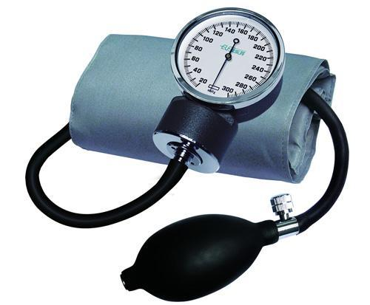
IV. Measuring Blood Pressure
Measured by a sphygmomanometer
Systolic blood pressure is the highest arterial pressure reached during ejection of blood from the heart
Diastolic blood pressure is the lowest arterial pressure when the ventricles are relaxing
Blood pressure decreases with distance from left ventricle

Slide 14
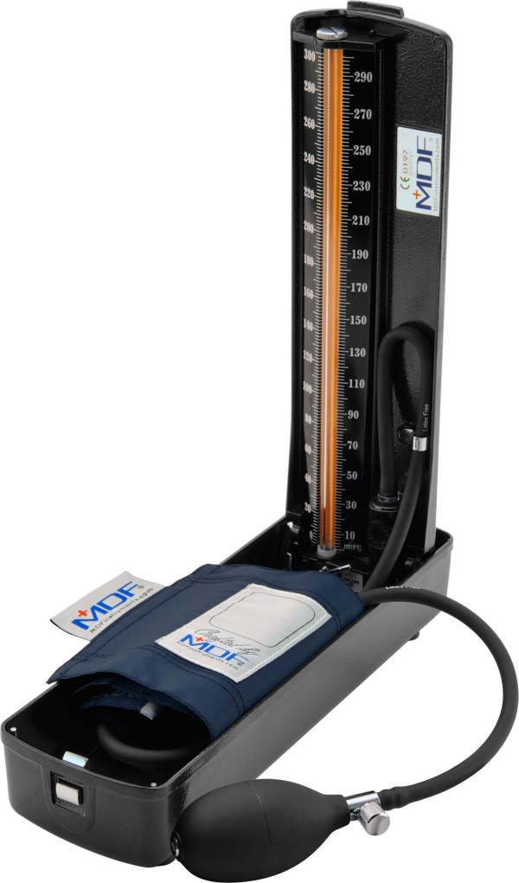
Normal resting blood pressure is 120 mm Hg over 80 mm Hg in brachial artery of arm
120 mm Hg is how high a column of mercury would be pushed as soon as the ventricles contract
As the ventricles relax, pressure decreases down to 80 mm Hg.
It would continue to decrease except that at this time the ventricles fill up and contract again pushing the pressure up to 120 mm Hg (again)

Slide 15
The drop in pressure from 120 mm Hg to 80 mm Hg is due to:
Elastic nature of the arteries
Blood being distributed throughout the body
Blood pressure drops as the blood is distributed to a “low” of about 10 mm Hg in the capillaries

Slide 16
By the time the blood reaches the venules and veins it does not have enough pressure to reach the heart on its own
Minute contractions of the skeletal muscle will push the blood back to the heart
Valves prevent backward flow
Ted-Ed 231/2 Hours
Notes:
http://ed.ted.com/featured/Mot8KdLT

