Slide 1
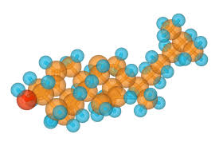
Neutral Fats, Steroids & Phospholipids

Slide 2
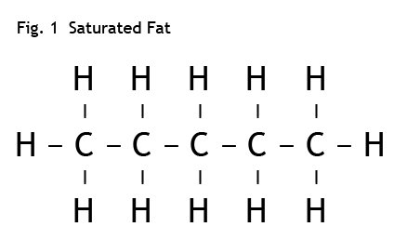
I. General Info
Animation
Large molecule, insoluble in water (non-polar)
Used for long-term storage of energy (more efficient [more E stored per cm³] than glycogen or starch)
Ex. Vegetable oils, animal fats

Slide 3
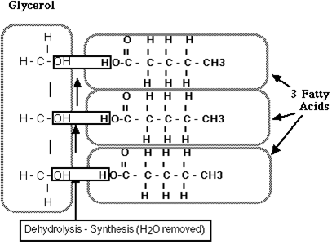
II. Structure
Neutral Fat
A glycerol (1,2,3-propantriol, for you IUPAC fans!) (3 carbon) backbone with 3 fatty acids attached - triglycerol
A fatty acid is: a hydrocarbon chain with a carboxylic acid at one end

Slide 4
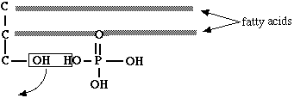
Phospholipid
Same as fat, but with the third fatty acid group replaced by a phosphate group! (simplified)

Slide 5
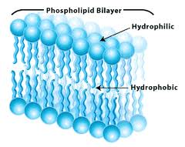
The phosphate head is polar
The hydrocarbon chains are non-polar
The major component of cell membrane
Membrane structure: a double layer of these, positioned with heads “out”, tails “in”

Slide 6
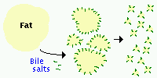
When added to dishwater, soap will disperse through it, and form droplets with any non-polar greasy guck in the dishwater (called Emulsification)
Same principle used in mammal digestive system: Bile is the emulsifier that breaks
Animation

Slide 7
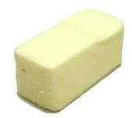
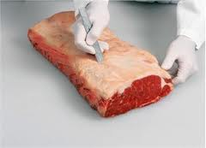
III. Saturated and Unsaturated Fats
Saturated
All C-C bonds are single
Tend to be solid at room temperature
Ex. Lard, butter, animal fats

Slide 8
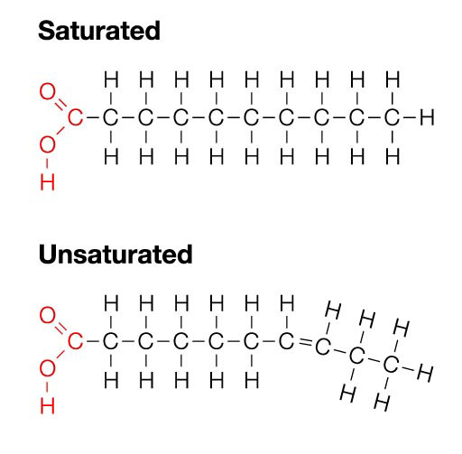
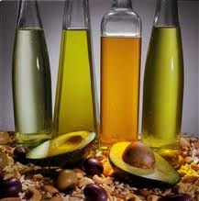
Unsaturated
Some C-C bonds are double
Tend to be liquid at room temperature (“kinks” in the chain formed by double bonds prevent close packing)
Ex. Olive oil, corn oil, peanut oil

Slide 9
H H H H H
H-C-C=C-C-C=C=C-C-H
H H H H H
Monounsaturated
One carbon atom not saturated
Polyunsaturated
Many double bonds (therefore fewer H’s)

Slide 10
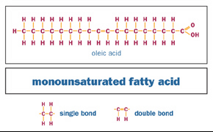
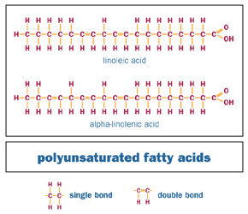

Slide 11
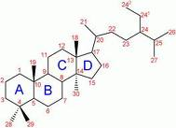
IV. Steroids
4 carbon rings (5 or 6 carbons per ring)
Ex. Cholesterol
A vital component of eukaryotic cell membranes
Is modified to synthesis hormones like estrogens, testosterone, aldosterone
Synthesized by body and eaten in animal flesh/fat

Slide 12
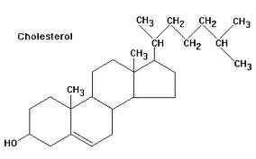
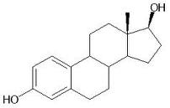
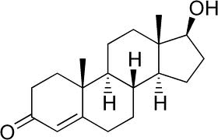
Cholesterol
Estradiol
Testosterone

