Slide 1
What is DNA?

Slide 2
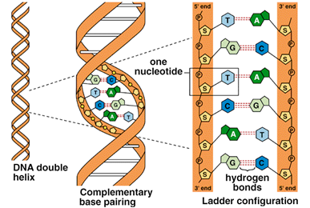
The structure of DNA and RNA
DNA = deoxyribonucleic acid
DNA is the control molecule of cells (and hence life)

Slide 3
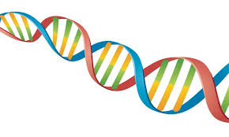
DNA has 3 major functions!
DNA controls cellular activities including reproduction
DNA carries a code: Genetic instructions are encoded in the sequence of bases strung together in DNA
DNA from male and DNA from female together become the genetic information of offspring in sexual reproduction
RNA molecules function in the processes by which those DNA “instructions” are used in building the proteins on which all forms of life are based

Slide 4
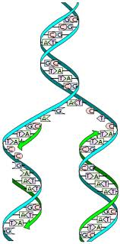
DNA makes exact copies of itself to pass onto other cells
DNA does this through a process called “replication”

Slide 5
DNA undergoes mutations
Mutations and recombination in the structure and number of DNA molecules are the source of life’s diversity
Evolution, in essence, proceeds from the level of DNA
Different combinations of DNA sequences due to mutations and sexual reproduction explain the existence of all the different species that have lived on this Earth

Slide 6
Furthermore…
DNA is a source of the unity of life
Life most likely began as a nucleic acid (recall that there are two types of nucleic acids: DNA & RNA)
The first form of life on this planet is thought by many biologists to be a self-replicating strand of RNA

Slide 7
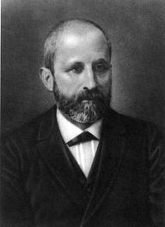
A brief history of DNA Research (no, this is not on the test!)
DNA was first isolated by the Swiss biochemist Johann Friedrich Miescher in 1869. Because DNA molecules are acidic and are found in the nucleus, Miescher called them nucleic acids. Over 80 years passed, however, before scientists understood that DNA contains the information for carrying out the activities of the cell. How this information is coded or passed from cell to cell was unknown. To break the code, scientists first had to determine the structure of DNA..

Slide 8
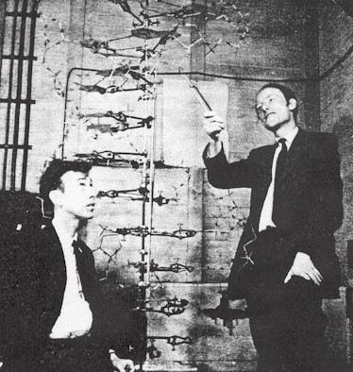
During the 1950’s, a fierce competition to determine the three dimensional structure of DNA took place. The race was won in 1953 by James Watson, an American biologist and Francis Crick, a British physicist.

Slide 9
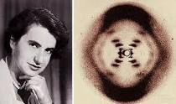
Working together at Cambridge University in England, Watson and Crick solved the puzzle using scale modes of nucleotides. Their success depended a great extent on evidence collected by other biologists, especially X-ray data from British biochemists Rosalind Franklin and Maurice Wilkins.

Slide 10
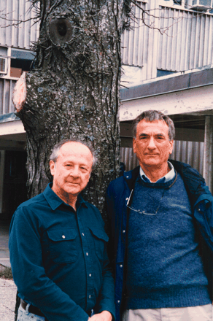
In 1958, the mechanism for DNA replication was determined by Meselson and Stahl. In the genetic code of 3 DNA nucleotides for 1 amino acid was worked out by Crick and his coworkers

Slide 11
Important Dates in Early DNA Research
Date | Discovery
1869 | Nucleic Acids identified
1928 | Transfer of genetic material between bacteria observed (Frederick Griffith)
1944 | DNA carries genetic code (Oswald Avery and coworkers)
1950 | Protein chains sometimes helical; DNA structure similar (Linus Pauling)
1951 | X-ray data for DNA structure produced (Franklin, Wilkins)
1951 | Nitrogen base ratio related to genetic code (Chargaff)
1953 | DNA double helix discovered (James Watson, Francis Crick)
1958 | Mechanism for DNA replication determined (Matthew Meselson, Franklin Stahl)
1961 | 3 DNA nucleotide code for 1 amino acid (Crick and coworkers)

Slide 12
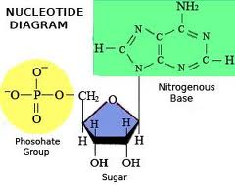
The Structure of Nucleic Acids
Animation
DNA & RNA are polymers of Nucleotides
Each nucleotide is composed of three parts:
A pentose (5 carbon) sugar
A phosphate group
A nitrogenous base

Slide 13
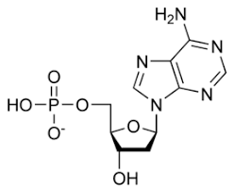
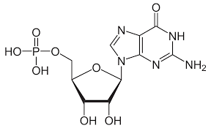
There are two types of bases
Purines – have a double ring structure (adenine & guanine)
Nucleotide: base = Adenine (A) Nucleotide: base = Guanine (G)

Slide 14
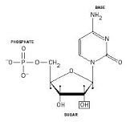
Pyrimidines – have a single ring structure (thymine, cytosine, uracil)
Nucleotide: base = Thymine (T)
Nucleotide: base = Cytosine (C)
Nucleotide: base = Uracil (U)
RNA ONLY

Slide 15
The DNA strand consists of a sequence of nucleotides linked together to form a double helix that can be visualized as an immensely long, twisted ladder

Slide 16
Phosphate – Sugar backbone
Each strand, or one side of the ladder, is composed of alternating molecules of deoxyribose and phosphate with a nitrogenous base attached to each deoxyribose unit
P
BASE
S
P
BASE
S
Notes:
Deoxyribose = sugar

Slide 17
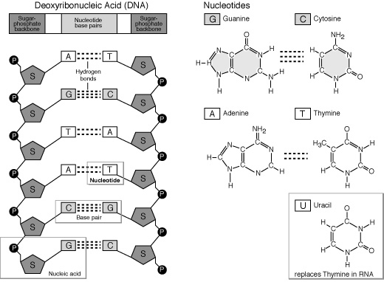
Synthesis
Nucleotides are connected by joining the bases of one nucleotide to the bases of the adjacent nucleotide (the ‘sugar-phosphate backbone’)

Slide 18
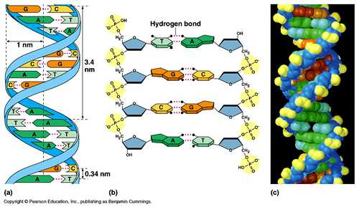
Pairs of joined bases project crosswise, forming the rungs of the ladder. The bases stick out of the side of the sugar molecules, and are linked to the bases of the other strand by hydrogen bonds in a very strict pattern. Always a purine with a pyrimidine.

Slide 19
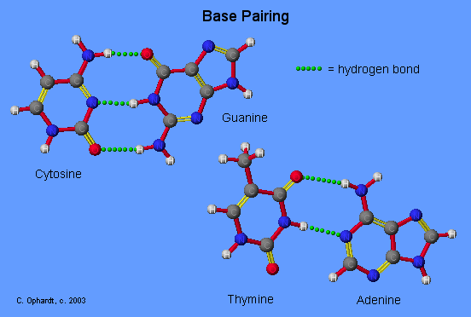
There is complementary base pairing between strands
Adenine (A) bonds with Thymine (T)
Guanine (G) bonds with Cytosine (C)

Slide 21
Note that the number of purine bases equals the number of pyrimidine bases.
The bases can be in any order, but always pair as above.
It is the sequence of bases that codes heredity information in the genetic code in DNA and RNA
Review the rules of complementary base paring below
A | T | G | T | G | A | T | C | C | A | C | G | C | G | T
II | II | III | II | III | II | II | III | III | II | III | III | III | III | II

Slide 22
Note that the number of purine bases equals the number of pyrimidine bases.
The bases can be in any order, but always pair as above.
It is the sequence of bases that codes heredity information in the genetic code in DNA and RNA
Review the rules of complementary base paring below
A | T | G | T | G | A | T | C | C | A | C | G | C | G | T
II | II | III | II | III | II | II | III | III | II | III | III | III | III | II
T | A | C | A | C | T | A | G | G | T | G | C | G | C | A

Slide 23
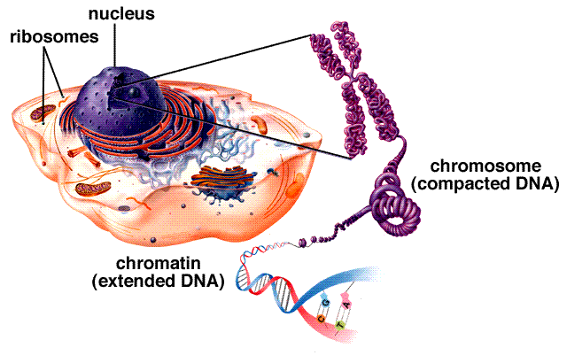
DNA strands are extremely long, each one containing millions of atoms. Every human cell contains about one meter of these twisted strands (this amounts of about 4 billion pairs of bases)

Slide 24
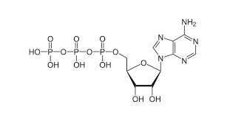
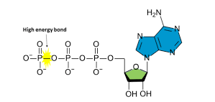
ATP – Adenosine Triphosphate: the molecule of energy
ATP is a type of nucleotide that is used as the primary carrier of energy in cells.
Consists of the sugar Ribose, the base Adenine, and 3 phosphate groups attached to the ribose

Slide 25
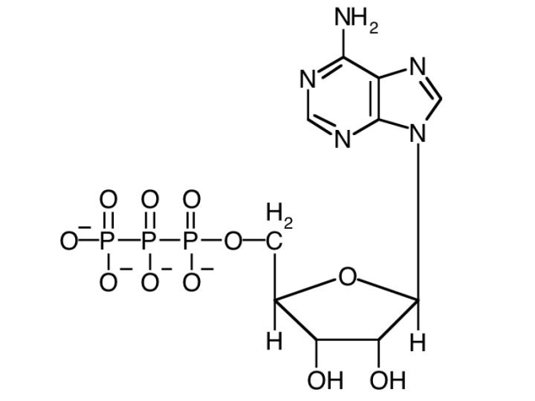
The bonds between the outer two phosphates is very high energy: when it is broken, much energy is released, which can be used by the cell (ex. For muscle contraction)
The bond between the first and second phosphate is also high in energy, but not as high as between the two end phosphates
ATP is produced mostly inside mitochondria during the process of cellular respiration

Slide 26
ATP breaks down to release 1 phosphate and energy Now called ADP = adenosine diphosphate

Slide 27
Compare and Contrast DNA & RNA
 | DNA | RNA
Sugar | Deoxyribose (5 C sugar with one less oxygen) | Ribose (5 C. sugar with one more oxygen)
Bases | Adenine, Guanine, Thymine, Cytosine | Adenine, Guanine, Uracil, Cytosine
Strands | Double stranded, with base pairing | Single stranded
Shape | Double helix shaped | Not double helix shaped
Location | Nucleus | Nucleus and cytoplasm
Length | Longer than RNA | Shorter
Kinds | 1 | 3 kinds (messenger - mRNA, transfer - tRNA, ribosomal - rRNA)

