Slide 1
Plasma Components
Plasma Constituent | Function | Source
Water | Maintains blood volume and transports molecules | Absorbed from large intestine
Plasma Proteins: Albumin Fibrinogen Globulins | All maintain blood osmotic pressure & buffer pH Transport Clotting Fighting infection | Liver Liver Lymphocytes

Slide 2
Plasma Constituent | Function | Source
Gases: Oxygen CO₂ | Cellular Respiration End product of metabolism | Lungs Tissues
Nutrients: Fats, glucose, amino acids, nucleotides, etc. | Food for cells | Absorbed from intestinal villi
Salts: Na⁺, K⁺, Cl⁻, NaHCO₃, etc | Maintain blood osmotic pressure/pH, aid metabolism | Absorbed from intestinal villi

Slide 3
Plasma Constituent | Function | Source
Waste: (urea, ammonia) | End products of metabolism | Tissues
Vitamins | Cofactors for enzymes | Absorbed from intestinal villi
Hormones (Thyroxin, adrenalin, estrogen, etc.) | Varied | Varied Glands

Slide 4
Blood Proteins
Are required for the transport of many molecules
For example, cholesterol is a lipid that is insoluble in plasma so it must be carried by proteins
Blood proteins also contribute to the viscosity of blood which aids in transport
Blood proteins also contribute to osmotic pressure, which maintains blood volume

Slide 5
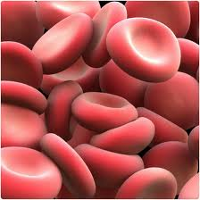
Blood Cells – Red blood cells (Erythrocytes)
Red blood cells (RBC) are small, biconcave, disk-shaped cells without nuclei
Makes up over 95% of the formed elements
Transport O₂, hydrogen ions and some CO₂

Slide 6
RBC are made by cells called stem cells
Over 2 million produced per second!
Made in the skull, ribs, vertebrae, and ends of the long bones
Stem cells continuously divide
Pass through several developmental stages during which they lose a nucleus, gain hemoglobin and gets much smaller

Slide 7
Oxygen levels in blood determine the rate of RBC formation
When oxygen tension is low, the kidneys produce a chemical called renal erythropoietic factor (REF) that, after combining with globulin from the liver, causes the bone marrow to produce more RBC
RBC love for only 120 days
RBC are destroyed in the liver and spleen
Iron is recovered from the hemoglobin and sent to the bones, while the heme portion is chemically degraded and is excreted by the lover in the bile as bile pigments

Slide 8
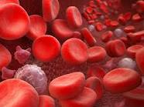
Blood Cells – White blood cells (leukocytes)
White blood cells (WBC) are usually larger than RBC (8 – 20 m), have a nucleus, and appear white (stained blue).
There is 1 WBC for every 600 RBC
Animation
Notes:
http://www.youtube.com/watch?v=tDTLC2swhlQ

Slide 9
WBC fighting infection Animation 2
Primarily dependent on neutrophils and lymphocytes
Red bone marrow continually produces WBC, expect lymphocytes and monocytes, and keeps a reserve ready
Lymphocytes and monocytes are produced by lymphatic tissue located in the lymph nodes and spleen
When a parasite or virus invades, the reserves of WBC are released and more are manufactured
Fever is caused by the increased production of WBC
WBC are very specific for various illnesses so their count can help doctors diagnose patients
Ex. Mononucleosis characterized by greater numbers of dark staining lymphocytes
Notes:
http://www.youtube.com/watch?v=0TvTyj5FAaQ

Slide 10
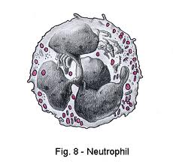
D. There are 2 main types of WBC
Granulocytes – have granules in the cytoplasm and a many-lobed nucleus joined by nuclear threads (called “polymorphonuclear”)
Neutrophils
55 – 70% of WBC
Phagocytize primarily bacteria
The granules are lysosomes

Slide 11
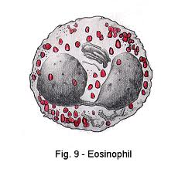
Eosinophils
1 – 4 % of WBC
Phagocytizes and destroys antigen-antibody complexes
Involved in inflammatory and allergic responses
Basophils
0.5 – 1 % of WBC
Involved in inflammatory and allergic responses
Congregates in tissues, releases histamine when stimulated

Slide 12
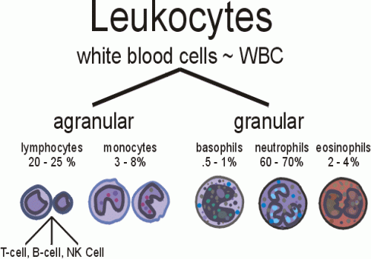

Slide 13
D. There are 2 main types of WBC
Agranulocytes: Do not have granules, and have a circular (lymphocytes) or indented (monocytes) nucleus
Lymphocytes
20 – 30 % of WBC
Are the smallest white blood cells
Different types: T and B cells
Type T lymphocytes kill virus-containing cells
Type B lymphocytes produce antibodies in blood and lymph

Slide 14
Secrete a protein called immunoglobulins
Antibodies combine with foreign substances to inactivate them
When microbes invade the body, lymphocytes begin to multiply and they become transformed plasma cells
Each microbe stimulates only one type of lymphocyte to multiply and form one type of plasma cell
The type of plasma cell formed is the type that can make a specific antibody to destroy the particular microbe that has invaded the body

Slide 15
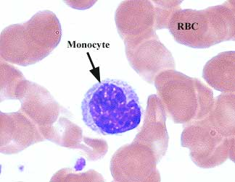
Monocytes
2 – 8% of WBC
Become macrophages
Enlarge greatly in size at infections

Slide 16
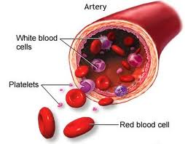
III. Platelets (Thromobocytes)
From fragmentation of large cells called megakaryocytes in red bone marrow
Produces 200,000,000,000 per day!
Function in blood clotting

Slide 17
IV. Hemoglobin (Hb)
Made of 4 amino acid chains (2 alpha (⍺) and 2 beta (β)
Each chain has iron-containing heme group which attaches to oxygen
Hemoglobin is an excellent carrier of oxygen because it weakly binds with oxygen in the cool, neutral conditions in the lungs, and easily gives O₂ up in the warmer and more acidic tissues

Slide 18
Hemoglobin is a red pigment so blood cells appear red
Color can change based on what the hemoglobin is attached to
Oxyhemoglobin (HbO₂)
Hemoglobin bound to oxygen
Bright red
Reduced hemoglobin
Hemoglobin that has lost its oxygen
Dark purple

Slide 19
Carbon monoxide (CO) is a poison found in car exhaust
It binds to Hb better than oxygen, and stays bound for several hours regardless of the environmental conditions
CO poisoning can lead to death

