Slide 1
Cell Theory

Slide 2
Cell Theory
The Wacky History of Cell Theory

Slide 3
Cell Theory
The cell is the basic unit of life.
All organisms are composed of one or more cells.
All cells come from other living cells.

Slide 4
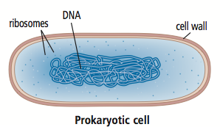
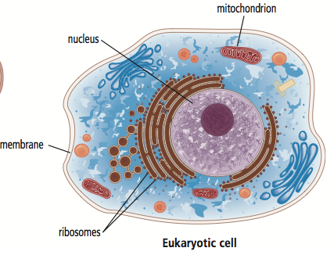
Groups of cells
Prokaryotic Cells
No membrane bound nucleus – has DNA
Simple cell
Ex. bacteria
Eukaryotic Cells
At least 10x larger than prokaryotic cells
Has a membrane bound nucleus
Ex. you and me!

Slide 5
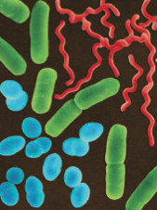
Groups of cells
Prokaryotic Cells – Bacteria!
Can be both harmful and helpful to humans
Harmful:
Helpful:
Three different shapes:
spirals (red)
rods (green)
cones (blue)

Slide 6
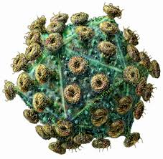
Groups of cells
Viruses
Non-living particles
Causes chicken pox, flu
Must have a living cell (host cell) to help it to reproduce
HIV

Slide 7
To do now!
Complete table using figure 1.29 on page 34 in textbook
Worksheet

