Slide 1
Biology Activity!
Individually, list 5 living things and 5 non-living things.
Share with the person sitting next to you! Put a checkmark beside any common items.

Slide 2
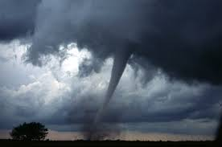
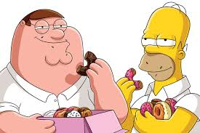
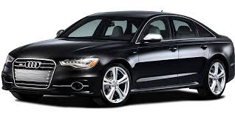
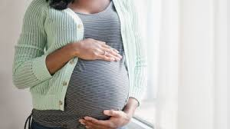
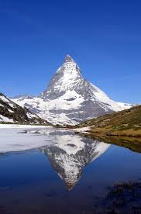
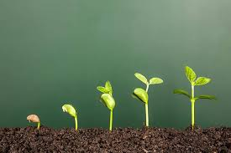
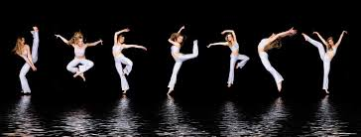
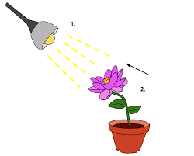
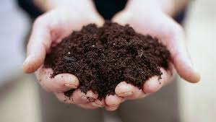
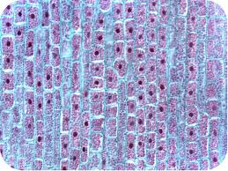
Identify the 7 living things from the pictures below.
For each living thing, write why you think it is living.
1.
2.
3.
4.
5.
8.
6.
7.
9.
10.
13.
11.
12.
Notes:
Show slide.
Tell them that there are 7 pictures of living things.

Slide 3
All Living Things…
Made up of cells.
Respond to environment/stimuli.
Need energy.
Move (at a cellular level).
Grow.
Reproduce.
Eliminate waste.

Slide 4
Observing Living Things

Slide 5
Living Things
Living things can survive in almost any type of environment.
All living things have special features that help them survive in their environment.

Slide 6
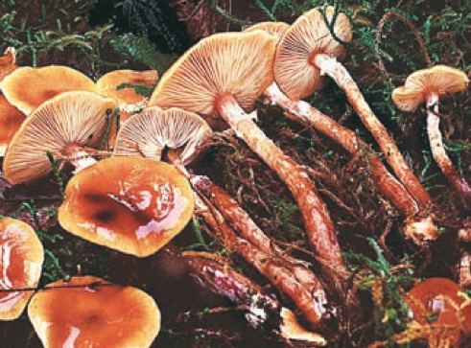
Honey Mushroom – largest living thing on Earth

Slide 7
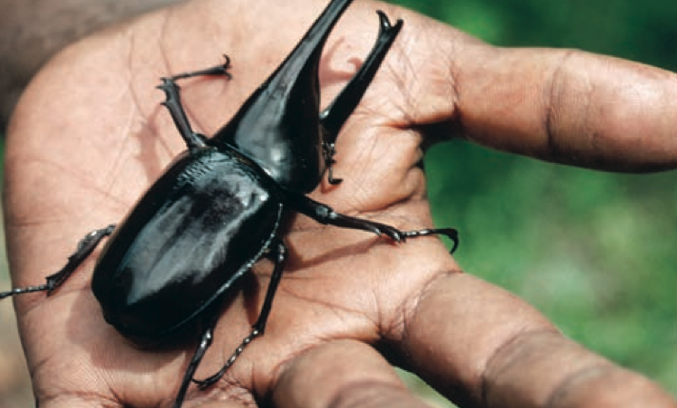
Rhinoceros Beetle – strongest living thing on Earth

Slide 8
Characteristic of Living Things
Living things… are made up of cells.
Cells– basic unit of life
Ex. Unicellular – organisms made up of one cell
Bacteria
Ex. Multicellular – organisms made up of more than one cell
Tree, dog

Slide 9
Characteristic of Living Things
2. Living Things… respond to environment/stimuli.
Anything that causes a living thing to respond is called a stimulus.
Ex. Hunger and thirst – causes you to eat or drink.
Ex. Dog flicks up ears in response to noise

Slide 10
Characteristic of Living Things
3. Living things… need energy.
To respond to the environment, living things require energy.
Living things have different ways of getting energy.
Ex: food for humans, carbon dioxide/water/sunlight for plants.

Slide 11
Characteristic of Living Things
4. Living things… move (at a cellular level).
All living things move in some way.
This may be obvious (animals walking) or less obvious (plants that move towards the sun).
A microscope may be needed to observe movement at a cellular level.

Slide 12
Characteristic of Living Things
5. Living things… grow.
Growth is a result of cells in your body increasing in number.
Cells are continually being replaced.

Slide 13
Characteristic of Living Things
6. Living things… reproduce.
A way for living things to replace older individuals that die.

Slide 14
Characteristic of Living Things
7. Living things… must get rid of wastes.
What living things consume are not always used by the body and therefore creates waste.
Animals produce waste such as carbon dioxide, urine and feces.

