Slide 1
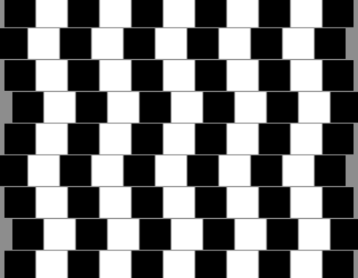
Human Vision

Slide 2
Parts of the EYE – label your diagram
PUPIL: An opening where light enters the eye
IRIS: Muscle that surrounds the pupil
CORNEA: Transparent material that covers the iris and pupil and holds the eye together.
SCLERA: A white region around the iris.
LENS: A flexible convex structure behind the pupil and iris
RETINA: A screen at the back of the eye where the image is formed.
OPTIC NERVE: The nerve through which the retina communicates with the brain.

Slide 3
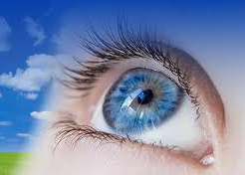
FOCUSING SYSTEM
The focusing system consists of:
Cornea
Lens
Spaces in the eye filled with watery fluid (aqueous humour).
Light rays focus as soon as they pass into the cornea.
The cornea refracts and focuses the most of the light.
The lens fine-tunes the focus.

Slide 4
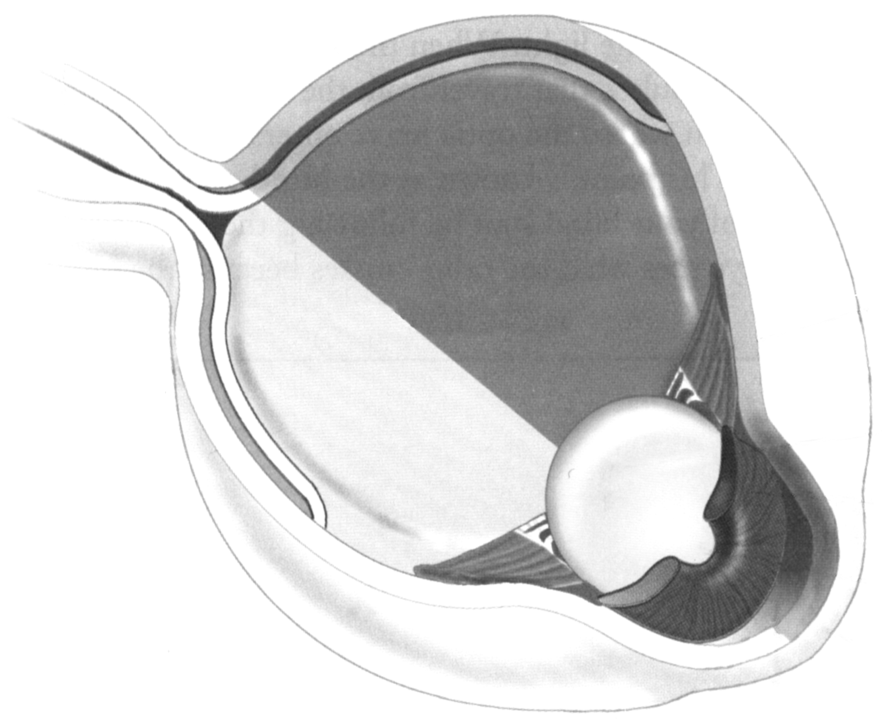
Parts of the EYE – label your diagram

Slide 5
FOCUSING SYSTEM

Slide 6
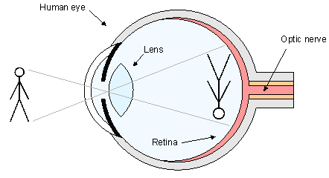
FORMING AN IMAGE
All light rays are straight lines.
The image formed by the lens is inverted
Your brain interprets the image as being upright

Slide 7
BLIND SPOT
The area where the optic nerve enters the retina.
Can you find your blind spot?
Page 205
X and O

