Slide 1
The story so far…
What happens to the light rays as they enter the eye through the pupil?
Where does most of the focussing in the eye occur?
How does the lens change to focus on objects that are close?
How does the lens change to focus on objects that are distant?
Why is the image of an object inverted when it strikes the retina?

Slide 2
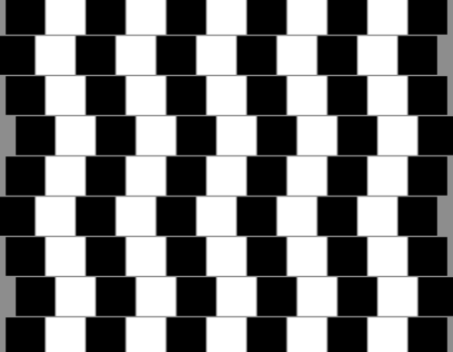
Vision Problems

Slide 3
BW & Colour Vision
There are specialized cells in your retina that absorb and detect light.
Rod Cells
Rod cells absorb green light particularly well.
Even though rod cells absorb colour, our brains use rod cells to detect light and dark.
This is called our black and white vision system

Slide 4
BW & Colour Vision
Cone Cells
Cone cells are used to detect colour
There are three types of cone cells that detect the colours red, green and blue.
These three colours are important because they are the primary colours of light

Slide 5
Correcting Focus Problems
Normal Vision
Most of the fine-focusing takes place in the lens
The lens is able to fine-tune the image by changing it shape
The lens is convex in shape and the light rays converge at the retina

Slide 6
Correcting Focus Problems
Near-Sighted Vision
People who are near-sighted can see nearby objects but cannot see far
The eye has a longer shape than the normal eye
The lens converges the light rays to form an image in front of of the retina causing a fuzzy image
Vision is corrected with a concave lens

Slide 7
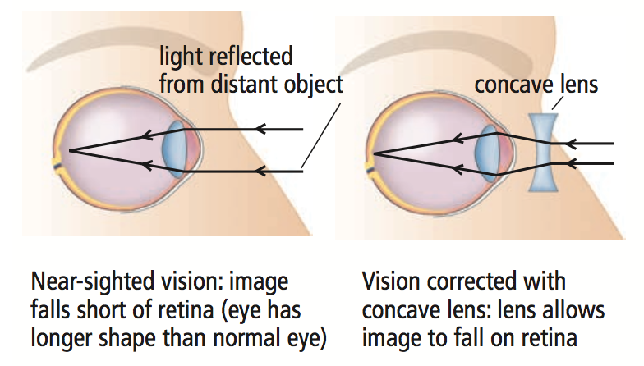

Slide 8
Correcting Focus Problems
Far-Sighted Vision
People who are far-sighted can see distant objects but cannot see near
The eye has a shorter shape than the normal eye
The lens converges the light rays to form an image behind the retina causing a fuzzy image
Vision is corrected with a convex lens

Slide 9
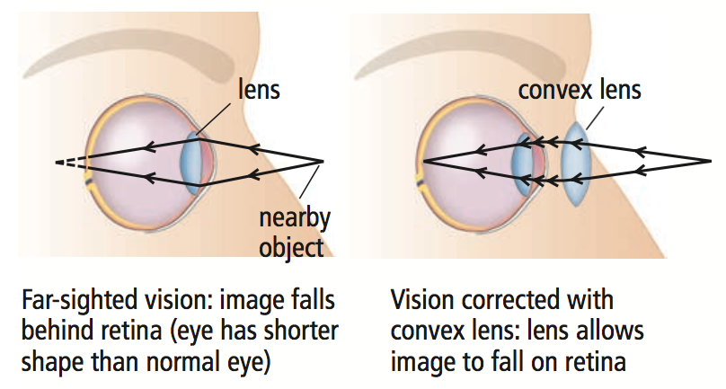

Slide 10
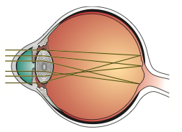
Correcting Focus Problems
Astigmatism
Astigmatism is caused when the cornea has a distorted shape
The image focuses on more than one point on the retina
Astigmatism can be corrected using eyeglasses or contact lenses.
An individual can also undergo laser surgery to reshape the cornea

Slide 11
Blindness
Blindness is any vision impairment that keeps an individual from taking part in life’s activities.
It can range from not being able to detect any light to being able to perceive some light.
Blindness can often be a result of disease or malnutrition.

Slide 12
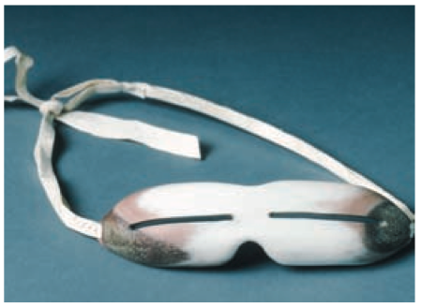
Other Types of Blindness
Snow Blindness: Painful condition of temporary partial or complete blindness caused by overexposure to the glare of sunlight
Treatment for snow blindness: resting the eyes in the dark

Slide 13
Other Types of Blindness
Night Blindness:
A condition in which it is difficult or impossible to see in dim light
The most common cause is the rod cells losing their ability to respond to light

Slide 14
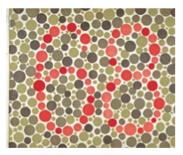
Other Types of Blindness
Colour Blindness:
The ability to see only in shades of grey
It occurs in about one person in every 40 000
An advantage of a person who is colour-blind is: to not be distracted by colourful distractions
The most common kind of colour vision deficiency is the inability to tell red and green apart
www.enchroma.com

