Slide 1
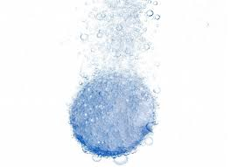
Antacid Challenge
Science 8

Slide 2
Put on safety goggles.
Obtain two beakers and label A and B.
Beaker A will be the control and Beaker B will be experimental.

Slide 3
Obtain two antacid tablets.
Surface Area Group: In your results table, label what consistency of antacid tablet will be in each beaker.
Tablet A: Not-crushed
Tablet B: Crushed

Slide 4
Obtain exactly 200 mL of your liquids using the graduated cylinders provided and pour into the beakers.
Temperature Group: In your results table , label what temperature of water will be in each beaker.
Liquid A: Room Temperature Water
Liquid B: Hot Water
WARNING: Pour the hot water into a beaker before pouring it into the graduated cylinder.

Slide 5
In your results table (next page), record qualitative AND quantitative observations of both tablets and both liquids.
What are some qualitative and quantitative observations you could make? Make a list.

Slide 6
Get timer ready!
Drop Tablet A into Beaker A and Tablet B into Beaker B at the same time. Start the timer immediately.
Record only qualitative observations in the results table.
What are some qualitative observations you could make?

Slide 7
Wait for tablets to dissolve completely. Record the reaction time of each tablet and write this time in your results table.
In your results table, record qualitative and quantitative observations for Beaker A and Beaker B.
What are some qualitative and quantitative observations you could make?

Slide 8
Pour the contents of beakers into the sink and rinse glassware with plenty of water.
Place all cleaned glassware on lab table.
Have your teacher check and initial your lab space.
Wash your hands and high five your partner.

