Slide 1
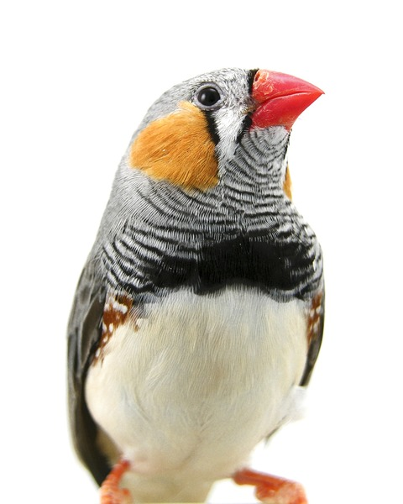
Evolution and Life’s Diversity
Ch. 13 and 14
Evolution: the process
by which modern organisms have descended from ancient organisms

Slide 2
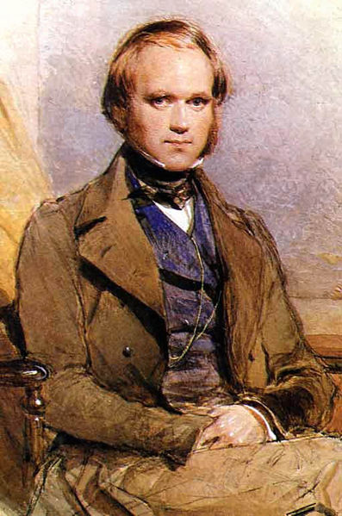
Darwin’s Dilemma
Full name: Charles Robert Darwin
His voyage:
22 years old at departure
Vessel name: Beagle

Slide 3
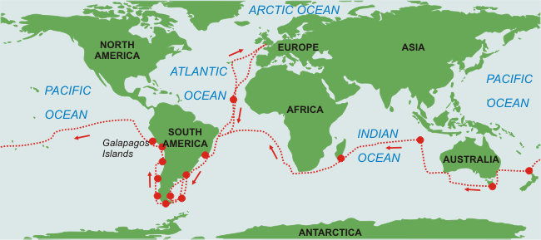
Route taken:
What he did during the voyage:
Went ashore and collected animal and plant species

Slide 4
On board he:
Got sea sick
Examined his specimens
Filled his notebooks with his thoughts and observations
Spent many hours reading the most current scientific books

Slide 5
The Diversity of Life
Biodiversity: the variety of living things
Why was travel a significant contributing factor to Darwin’s work?
He saw countless of different living things
Current estimates of the number of living species range from 3 million to 20 million
99.9% of species that lived on Earth at some time are now extinct

Slide 6
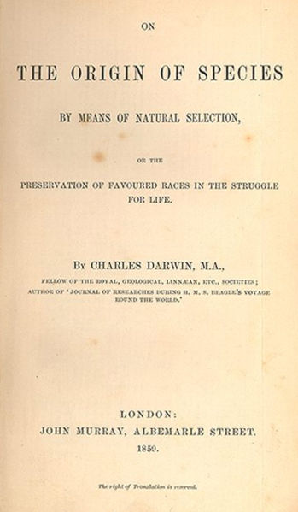
III. Fitness: To survive and Reproduce
Fitness: the physical traits and behaviours that enable organisms to survive and reproduce in their environment
Darwin’s book: The Origin of Species by Means of Natural Selection
Published: 1859

Slide 7
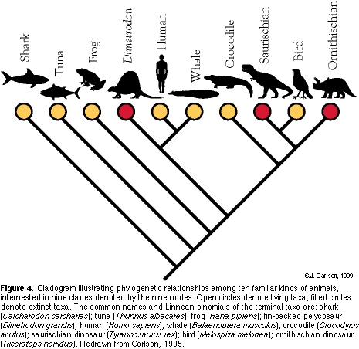
In it he argues that : just as with each new organism comes from preexisting organisms, each species has descended from other species over time. If you look back far enough in time, you will see that all species have shared or common ancestors.
This principle is called common descent

Slide 8
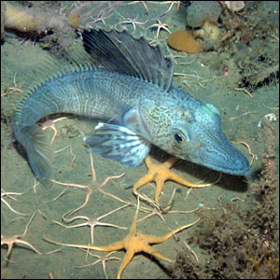
Darwin also says that fitness arises through adaptation
Adaptation: any inherited characteristic that increases an animal’s or plant’s fitness for survival
Amazing adaptationOne of the extraordinary adaptations which evolution generates in the extreme Antarctic cold is found in the ice fish.
It has evolved to have no red blood cells and no haemoglobin, meaning that its blood flows more freely. The oxygen which its muscles need simply dissolves in the blood.
(Image: J Gutt, Alfred Wegener Institute)

Slide 9
13-2 Age of the Earth
Evidence in stone
Past beliefs:
- Age: a few thousand years
- Features (mountians, valleys, etc) produced by sudden catastrophic events that humans rarely witnessed and could not understand

Slide 10
Evidence that the Earth was old began to accumulate…
Scientist: | Year: | What they said:
James Hutton | 1788 | Rocks, mountains and valleys had been changed gradually by rain, heat, cold, the activity of volcanoes, and other natural forces. These proceses operate slowly so the Earth had to be much more than a few thousand years old.
Charles Lyell | 1830 | That scientists must always explain past events in terms of events and processes they could observe themselves because that was the only way the scientific method could work
Professional and amateur geologists | N/A | Found fossils (def’n): (do yourself) b) Some did not resemble species on Earth today, such as:

Slide 11
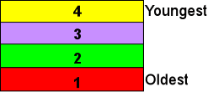
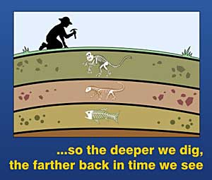
II. The geologic Time Scale: A clock in the rocks
Therefore fossils found in lower layers are older than those found above
ANIMATION
Relative dating relies on the position of one fossil compared to another
Lower rocks were deposited before upper layers and therefore had to be older (Law of Superposition)

Slide 12
Radioactive Dating
Uses radioactive elements in rock that decay at a known rate. These are called radioactive elements
1. ²³⁸U ²⁰⁶ Pb w/ half-life of 4.5 billion yrs
2. ⁴⁰K turns into ⁴⁰ Ar w/ half-life of 1.3 billion yrs
3. ¹⁴C turns into ¹⁴N w/ half-life of 5770 yrs

Slide 13
Q: Which system would be the best choice to date:
A rock sample thought to be 3.5 billion years old?
Uranium
A wooden post thought to be 20000 years old?
Carbon

Slide 14
Absolute dating
Method of measuring rates of decay of radioactive materials to determine how long ago an event occurred or an organism lived.
Current estimate of the Earth’s age: 4.5 billion years old.

Slide 15
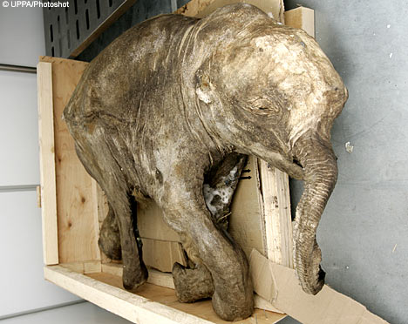
The Fossils Record
In cold places, animals sometimes fell into crevasses in ice or became trapped in snow fields
The six-month-old female calf was discovered on the Yamal peninsula of Russia and is thought to have died 10,000 years ago. The animal’s trunk and eyes are still intact and some of its fur remains on the body.

Slide 16
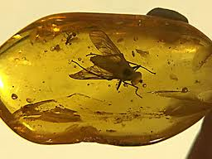
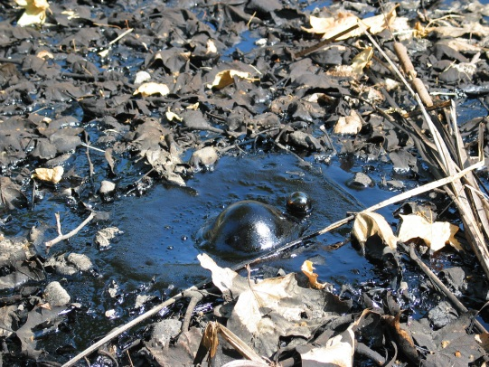
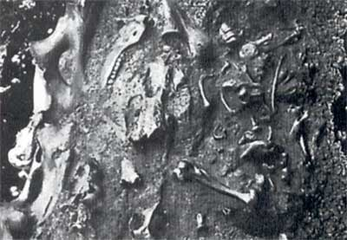
How fossils form:
In tree sap, insects and other small animals were occasionally trapped
When animals got stuck in peat bogs, quicksand or tar pits

Slide 17
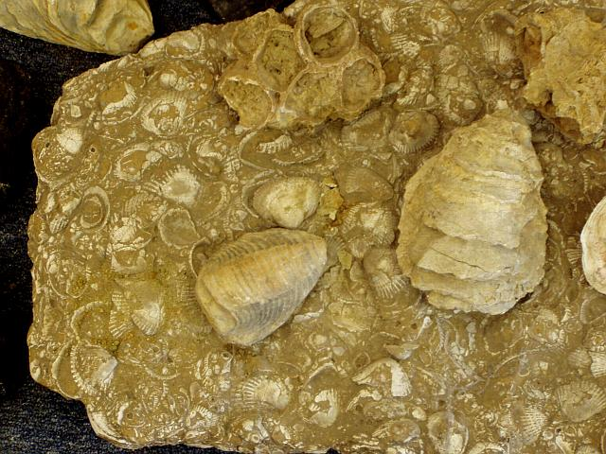
Most are formed in sedimentary rock when small particles as well as dead organisms are deposited to lake or ocean bottoms

Slide 18
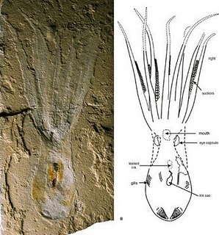
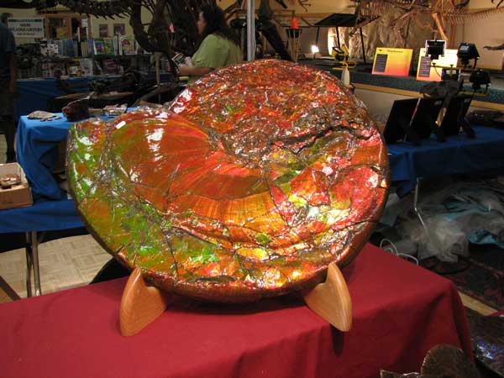
Pressure turns loose sediments into rock by the upper layers compressing the lower layers
A record is made of soft body parts by: small particles of rock that buried plant or animal remains
A record is made of hard body parts by replacing the wood, shells, or bones with long lasting mineral compounds - petrified

Slide 19
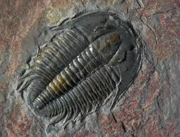
II. Fossil Evidence: Problems in assembling the puzzle
What is the significance of “chance” with respect to the fossil record?
The significance of chance by which organisms are fossilized means that the fossil record is not as complete as we would like it to be.
For every organism that leaves a proper fossil, many die and vanish without leaving a trace

Slide 20
Name an organism that has a very low chance of forming a fossil, and explain why?
A soft bodied organism that lives on land because the soft bodies don’t preserve as well and living on land tends to be harder to become a fossil

Slide 21
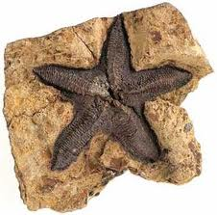
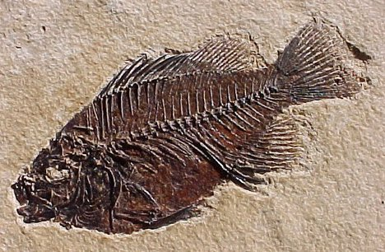
Fossils can be exposed by the weathering erosion of the rock around it
The quality of fossil preservation varies as well as the completeness of the sample

Slide 22
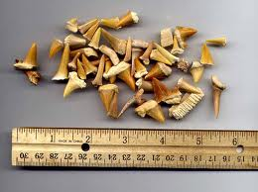
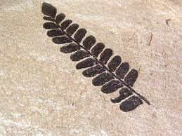
What the Fossil Record Tells Us
The fossil record represents: the preserved collective history of Earth’s organisms
It also tells of major changes in Earth’s climate and geography
Fossilized shark teeth have been found in Arizona indicating that the deserts of the American Southwest were once covered by ancient seas.
Giant fossil ferns found in Canada show that N. America once had a much warmer tropical climate

Slide 23
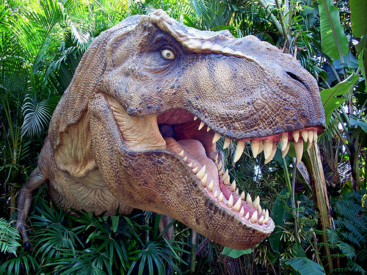
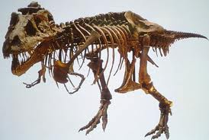
A consequence of this is that species die out!

Slide 24
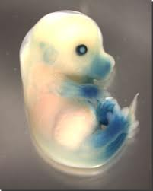
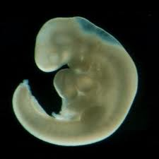
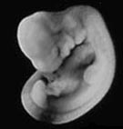
13-4 Evidence From Living Organisms
BIG PICTURE
Similarities in Early Development
Embry0: organism at an early stage of development
19th C. scientists noticed the embryos of many different animals looked so similar that it was difficult to tell them apart
Human Embryo Cat Embryo Mouse Embryo

Slide 25
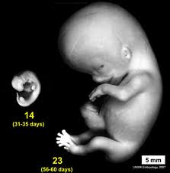
Similarities in early development indicate that similar genes are at work
These genes came from a common ancestor
As the embryos (of different species)
grow and develop, they become
more dissimilar

Slide 26
The changes in genes are caused by mutations, or changes in the genetic blueprint contained within an organisms DNA
Q: What happens to an organism with an “early” mutation?
Mutations that affect early stages od developments are likely to be lethal. An organism carrying such a mutation dies while it is and its genes are not passed on

Slide 27
Later mutations tend to be less drastic and may be potentially useful!
Organisms with this kind of mutation may survive to reproduce and pass the changes in its DNA to its offspring

Slide 28
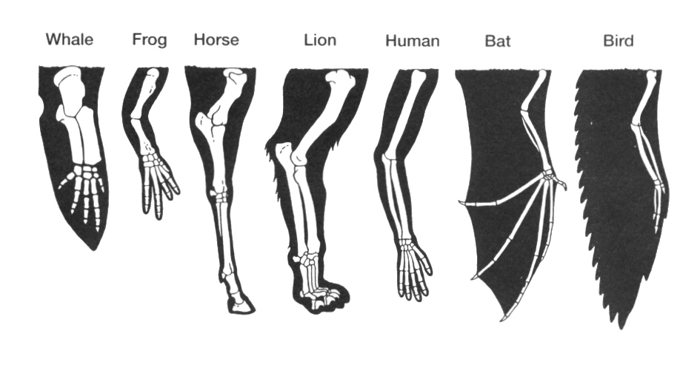
Similarities in Body Structure
Homologous Structures: parts of different organisms, often quite dissimilar, that developed from the same ancestral body parts
Fill in chart Fig 13-17

Slide 29
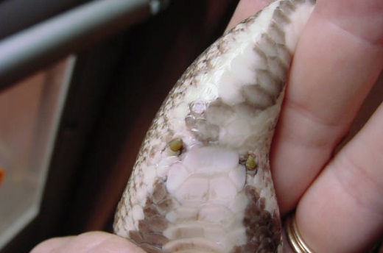
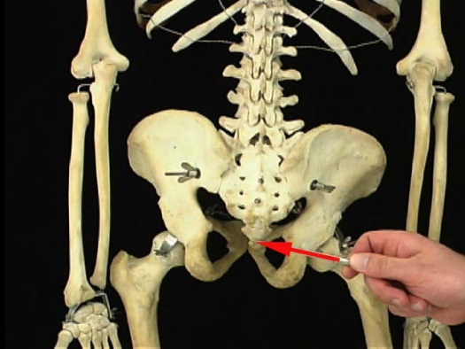
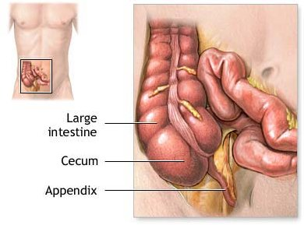
Vestigial organs: a structure that serves no useful purpose in an organism
Snake: have tiny bones that are the remnants of legs
Human:
Have a set of minature tailbones at the base of our spine
Ear muscles
Appendix: probably used in the digestion of food

Slide 30
Similarities in Chemical Compounds
All organisms use the following chemicals:
DNA and RNA to carry information
ATP to carry energy
The more closely related two species are, the more closely their important chemical compounds resemble each other.

Slide 31
What Homologies Tell Us
Similarities provide evidence that all living things evolved from common ancestors
The best explanation for them is that living organisms evolved through gradual modification of earlier forms
Descent from a common ancestor
Barbellus Animation

Slide 32
14-1: Developing a Theory of Evolution
Observing that evolution occurs is simple: explaining how & why is more difficult
The theory has been revised, but revisions do not mean that evolutionary change itself is debatable or that evolutionary theory is merely a collection of vague hunches that are not supported by evidence.

Slide 33
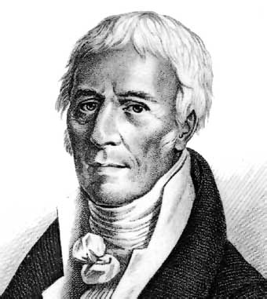
An Early Explanation for Evolutionary Change:
A. Prior to Darwin, Jean Baptist de Lamarck offered an explanation based on three assumptions:
Ted-ed Misconceptions of evolution
(These assumptions are totally incorrect but were the first thoughts about evolution)

Slide 34
LaMarck’s Assumptions
1. A Desire to Change
explanation: LaMarck believed that organisms change because they have an inborn urge to better themselves and become more fit for their environment

Slide 35
LaMarck’s Assumptions
2. Use and Diuse
explanation: believed that change occurred because organisms could alter their shape by using their bodies in new ways
3. Passing on Acquired Traits
explanation: believed that if an animal acquired a body structure during its lifetime, it could pass that change on to its offspring.

Slide 36
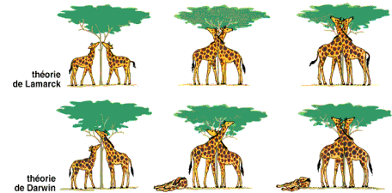
While incorrect, Lamarck’s contributions were significant because:
1. He was one of the first people to devise a theory of evolution and adaptation
2. He also brought the concept of evolution to the attention of scientists

Slide 37
Why Lamarck’s mechanisms don’t work:
1. Only genes and changes in genes are
passed from parents to offspring
2. There is no evidence that: experience during its life can cause specific changes in an organism's genes
3. The ‘weightlifter’ example: Years of proper exercise and diet, for example, can turn a weakling into a champion weight lifter. But that weight lifter's children cannot benefit genetically from the parent's pumping iron. If the children do not exercise and eat a proper diet, they will not develop large muscles, even if their parents were world champions!

Slide 38
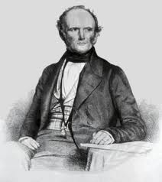
II. Ideas that Shaped Darwin’s Theory of Evolution Ted-ed Age of the Earth
Person/Idea: | Significance to Darwin’s Work:
Charles Lyell demonstrated that the Earth was very old and that it had changed over time | It was important that Earth was very old because it took long periods of time for millions of species to evolve from a common ancestor
In artificial selection the intervention of humans ensures that only individuals with the more desirable traits produce offspring | Variation either happened naturally or it did not. Nature must work in a process similar to artificial selection. This process would allow only those organisms best suited to their environment to survive and reproduce.

Slide 39
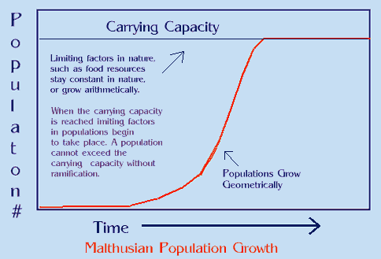
The Malthusian doctrine observed that human populations growth was prevented by famine, disease and war | The observation applied not only to humans but more to animals and plants because they produce even more offspring than we do.

Slide 40
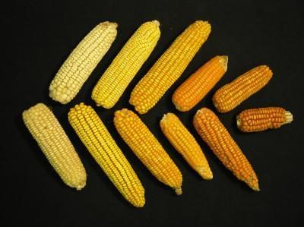
14-2: Evolution by Natural Selection
A.Darwin’s line of reasoning:
1. Wild animals and plants show variations (just like domesticated ones)
2. Birthrates are high
3.Resources (called in text life's necessities) are scarce

Slide 41
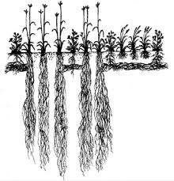
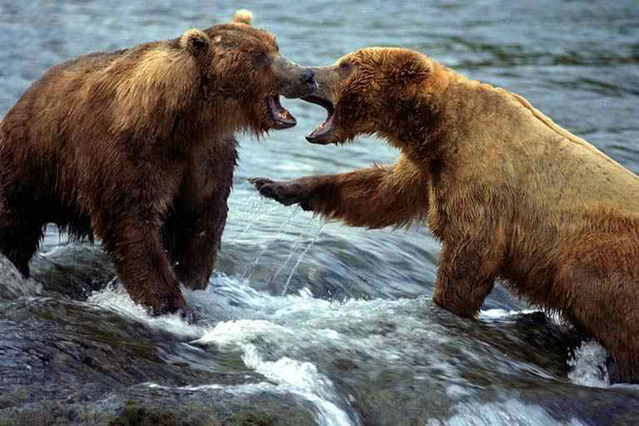
4. These two facts above force organisms into a “struggle for existence”
5. Against the environment (example:
plant stems grow tall in search of sunlight; plant roots grow deep into the soil in search of water and nutrients.)
6. Against each other (example: Animals compete for food and space in which to build nests and raise young.

Slide 42
B: Darwin’s Principle: Survival of the Fittest
Individuals whose characteristics are well-suited to their environment survive. Individuals whose characteristics are not well-suited to their environment either die or leave fewer offspring.
In what two ways is natural selection different from artificial?
1. Occurs over much longer periods of time
2. Occurs without any goal or purpose

Slide 43
Peppered Moths: Natural Selection In Action Evolution in Action
In the beginning (of the 19th C.)…..
1.Two colour variants of the moth: light-coloured (common) and dark coloured (rare)

Slide 44
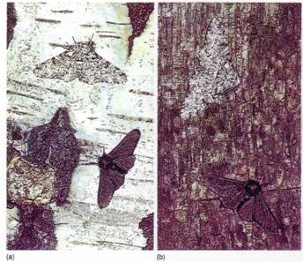
2. In daytime, moths hang out: resting
on the bark of oak trees
3 Tree bark colour: light brown speckled with green
4. Then… the Industrial Revolution!
5. Pollution (from: soot from burning coal) affected trees by staining the tree trunks dark brown.

Slide 45
B.Biologists noticed that population of moths was changing and that there were more moths with dark coloration.
C. Evolutionary theory would hypothesize:
1. The major predator of the moth: birds
How birds locate prey: eyes
3. Moths that blend in w/ their
surroundings are said to be camouflaged
4. As tree trunks darkened the
colour variant they favoured changed from the dark coloured moths to the light coloured moths
5. Now, the dark moths were more common and more of them survived and got a chance to reproduce, passing on their genes for dark colour to their offspring

Slide 46
D. British ecologist H.B.D. Kettlewell tested this hypothesis by breeding, marking, and releasing equal numbers of each type of moth in two areas: normally coloured trees and blackened soot trees. After some time, he re-captured and counted his marked moths, and he found that in unpolluted areas, more of the light-colored moths survived and in soot-blackened areas, more of the dark-colored moths survived.

Slide 47
14-3 Genetics and Evolutionary Theory
Darwin’s handicap: He had no idea how the inheritable traits were passed from one generation to the next.
Q. If Mendel was a contemporary of
Darwin, why did Darwin not know of Mendel’s findings?
Mendel's work remained unknown to most scientists until the early part of 20th century.
Genetic and evolutionary theory are inseparable. Today, we define fitness, adaptation, species, and the process of evolutionary change in genetic terms.

Slide 48
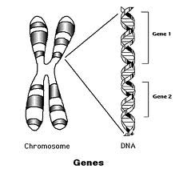
Genes: Units of Variation
Genes are:
Carriers of: of inheritable characteristics
Source of: random variation upon which natural selection operates
Ted-ed Gene Mutations
Other sources of variation:
Mutations
Shuffling during meiosis

Slide 49
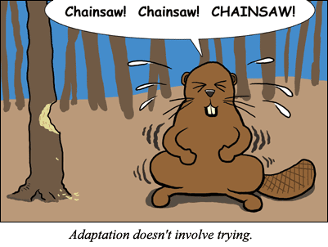
Variation doesn’t occur b/c animals NEED or WANT to evolve (Lamarck’s theory):
Organisms can’t
cause DNA changes
Organisms can’t
prevent DNA changes
Ted-Ed Evolution of Feathers

Slide 50
II. Raw Material for Natural Selection
Natural selection operates only on the phenotypic variation among individuals
Phenotype = physical and behavioral characteristics
Examples – traits that show phenotypic variation:
1. Height
2. Colour of skin/hair/eyes
3. Shape of nose/curves of lips
4. Amount of body hair
In nature, organisms show as many variations as humans
1. To the casual observer one zebra looks
much like any other zebra.

Slide 51
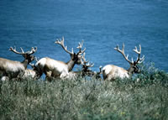
III. Evolution as Genetic Change
A. To describe evolution, biologists study
groups of organisms called populations.
1. Populations (def’n): is a collection of
individuals of the same species in a given area whose members can breed with one another
Ted-Ed Evolution in the Big City

Slide 52
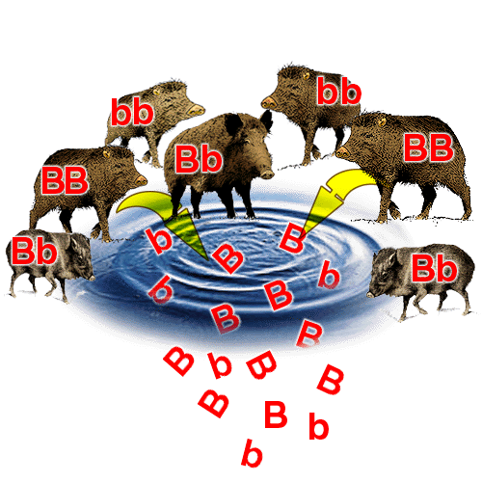
B. Offspring share a group of genes, called gene pool
Gene pool contains: a number of alleles for each inheritable trait
(eg bristle length)
Allele (def’n): forms of a certain gene at a given point on a chromosome

Slide 53
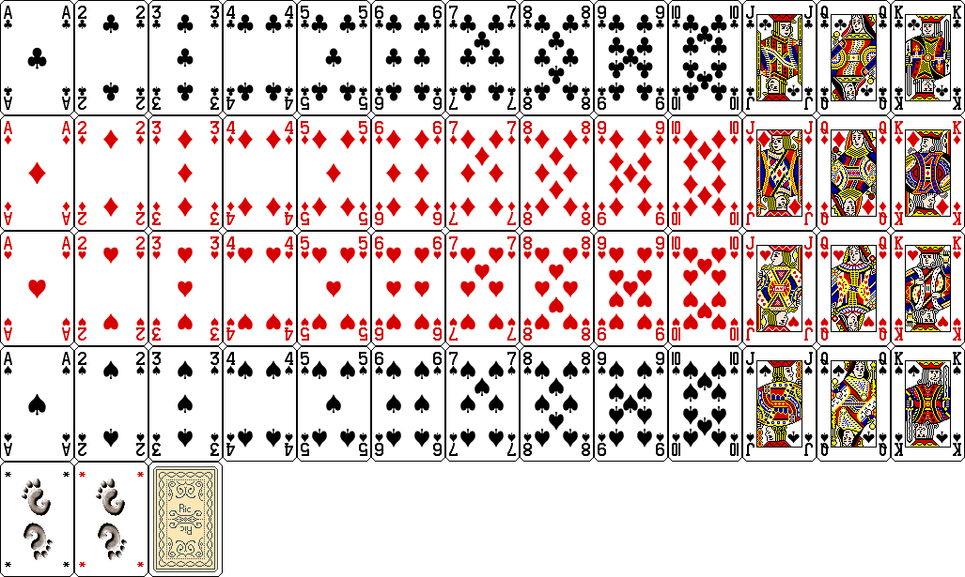
3. Relative frequency (def’n): the number of times an allele occurs in a gene pool compared with the number of times other alleles for the same gene occur
a.Sexual reproduction alone doesn’t change the relative frequency of alleles in a population
b. Shuffling alone
doesn’t change the
relative numbers of
aces, kings, fours, or
jokers in the deck

Slide 54
C. Evolution (new def’n): is any change in
the relative frequencies of alleles in the gene pool of a population
1. Peppered moth example: The alleles for dark color increased when more dark-coloured moths appeared in the population.

Slide 55
IV: Genes, Fitness and Adaptation
Adding “genes” to our definitions: segment of DNA that codes for a particular protein
Fitness (new def’n): combination of physical traits and behaviors that help an organism survive and reproduce in its environment
2. Adaptation (new def’n): process that enables organisms to become better suited to their environments

Slide 56
Weightlifter example:
Muscles acquired as a result of exercise are not passed on to offspring. Thus they cannot be considered an evolutionary adaptation and cannot contribute to evolutionary fitness. A gene that somehow allowed an individual to develop stronger muscles by doing less work or by eating less food, on the other hand, might be a useful adaptation under certain circumstances. This gene could be passed on to offspring.

Slide 57
V. A Genetic Definition for ‘Species’
Past def’n: as a group of organisms that looked alike
1. Used precise physical descriptions
2. Differences seen as among individuals
were seen as imperfections or mistakes
This approach doesn’t recognize that variation in a population is the rule rather than the exception.

Slide 58
New def’n of “species”: a group of similar-looking organisms that breed with one another and produce fertile offspring in the natural environment
1. Implications of interbreeding:
a. Share a common gene pool
b. Thus, a genetic change that occurs in one individual can spread through the population as that individual and its offspring mate with other individuals
c. If this change increases fitness, that gene will eventually be found in many individuals in the population

Slide 59
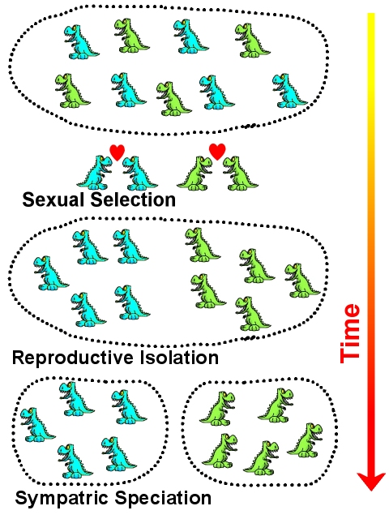
14-4 The Development of New Species
Speciation (def’n): how new species evolve from old ones

Slide 60
I.The Niche: How to Make a Living
Niche (def’n): the combination of an organisms' "profession" and the place in which it lives
No two species can occupy the same niche in the same location for a long period of time
Q. Why would a species occupying an empty” niche be better able to survive that one that “shares” a niche with another species?

Slide 61
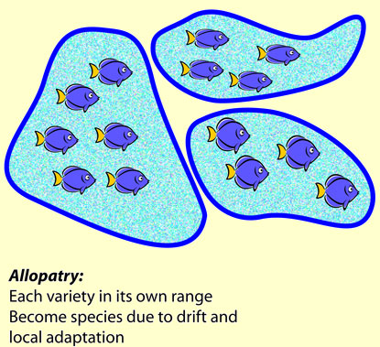
II. The Process of Speciation
New species usually form only when populations are isolated, or separated.
B. Reproductive isolation (def’n): separation of populations so that they do not interbreed to produce fertile offspring

Slide 62
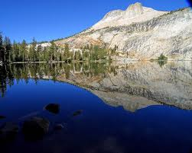
The agent for new species formation is: reproductive isolation
1. This may occur by:
a. Geographic barriers
- rivers, mountains, roads

Slide 63
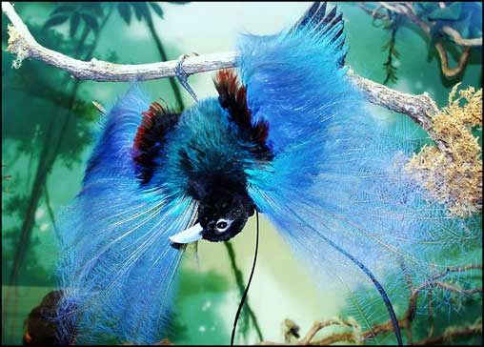
b. Differences in courtship behaviours
In species with courtship rituals (breeding calls, mating dances, etc.), there is usually a complex, give-and-take "ritual" before actual mating takes place. This prevents "wasted effort" with a partner who will not produce fertile offspring with you!

Slide 64
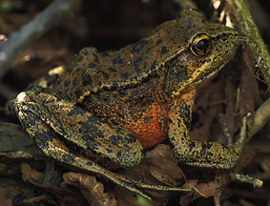
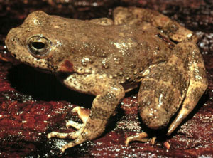
c. Differences in fertile periods
- two species whose ranges overlap have different periods of sexual activity (or breeding season)
Rana aurora -
breeds January - March
Rana boylii - breeds late March - May

Slide 65
2. Once reproductive isolation in place:
natural selection increases differences between populations
3. If genetic differences are sufficient, a
new species is formed

Slide 66
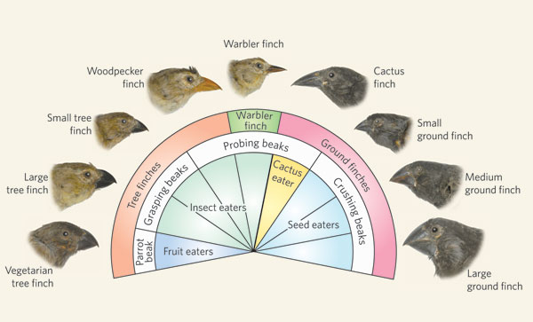
III. Darwin’s Finches: An Example of Speciation
A Darwin’s finches:
14 different species
2. Found on: Galapagos Islands

Slide 67
All evolved from a single ancestral species
4.Each exhibits unique:
a. Body structure
b. Behaviors

Slide 68
5. Each lives in a different niche, for e.g.:
a. Adapted to feed differently:
i. Some eat small seeds
ii. Others crack open much larger seeds
iii. seeds with thicker shells
iv. pick ticks
v. eat insects from inside dead wood
vi. drink the blood of large sea birds

Slide 69
6. Process:
Step 1: Founding Fathers & Mothers:
Arrival on the Galapagos Islands of a few ancestral finches
Step 2: Separation of Populations:
Some finches move from island A to
island B so they are isolated from each other

Slide 70
Step 3: Changes in the Gene Pool
Over time, the populations on each island became adapted to the needs of their environment
Step 4: Reproductive Isolation
The gene pools of the two bird groups do not mix because the two groups do not breed together → new species
Step 5: Sharing the Same Island
The two species occupy different niches so they can coexist together when sharing the same island

Slide 71
IV. Speciation and Adaptive Radiation
Adaptive radiation = divergent evolution
refers to one or a few species which diversify ("spread out") and generate multiple daughter species.

Slide 72
B. The opposite of this is Convergent evolution (def’n):
Phenomenon in which adaptive radiations among different organisms produce species that are similar in appearance and behavior; opposite of divergent evolution
C. Organisms exhibiting convergent evolution usually have analogous structures (def’n):
Structures that are similar in appearance and function but have different origins and usually different internal structures

Slide 73
Example:
a. Wings of butterfly made of thin nonliving membrane with an intricate network of supports
b. Wings of bird made of skin, muscles, and arm bones
c. Wings of bat made of skin stretched between elongated finger bones
d. In all cases, the function of these different structures: are the same

Slide 74
14-5: Evolutionary Theory Evolves
I. Genetic Drift Ted-Ed Five Fingers of Evolution
1. Biologists now realize that chance
plays an even larger role in evolution
2. Genetic drift (def’n): random change in
the frequency of a gene

Slide 75
3. How it works
A new or rare allele becomes common, by CHANCE, after only a few variations
b. Occurs most efficiently in small populations because chance events are less likely to affect all members of a large population

Slide 76
Rhinoceros example:
i. Indian rhino: one horn;
African rhino: two horns
ii. Natural selection provided a distinct advantage to individuals with horns, but the two populations developed different numbers of horns because of random genetic drift

Slide 77
II. Unchanging Gene Pools
A. If a species is well-adapted to its environment and it does not change over time
B. No new species enter into competition with it, that species may remain unchanged for long periods of time
Such species are called
living fossils

Slide 78
III.Gradual and Rapid Evolutionary Change
1. Gradualism (def’n): theory that evolutionary change occurs slowly and gradually
2. Species in equilibrium do not change very much between their appearance and their disappearance
3. Fossil record shows evidence of this equilibrium being upset: rapid changes over short periods of time

Slide 79
4. Some scientists think these “rapid” changes are what create new species
5. How they could happen:
1. In a small isolated population, genetic change can spread more quickly through fewer individuals
2. Small population migrates to a new environment
(empty niches!)
3. Dramatic changes on the Earth, e.g. mass extinctions, caused by global climate change
4. Mass extinctions = empty niches
6. Punctuated Equilibria (def’n): pattern of
long stable periods interrupted by brief
periods of change

