Slide 1
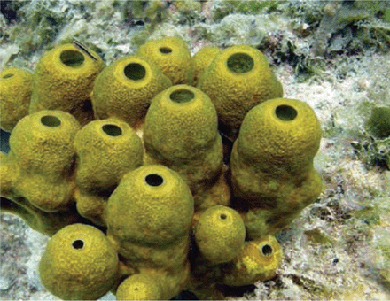
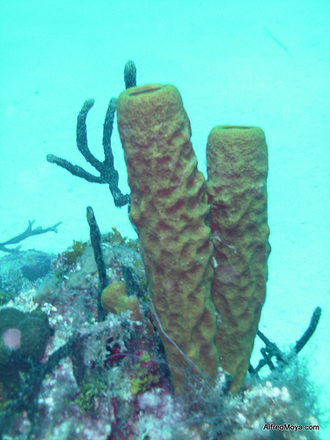
26-2: Sponges
I. Sponges
A. An ancient life form; sponges date back to
the beginning of the Cambrian period

Slide 2
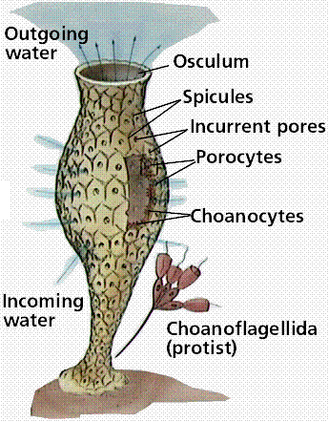
B. Habitat: live in the sea, although a few
live in freshwater lakes and streams
C. Phylum name Porifera means: pore-bearers because sponges have tiny openings all over their body

Slide 3
D: 3 characteristics of Phylum Porifera like most animals:
1. multicellular
2. heterotrophic
3. no cell walls
4. contain several specialized cell types
that live together

Slide 4
E. 2 characteristics of Phylum Porifera
unlike most animals:
1. have no mouth or gut
2. no specialized tissues or organ systems
F. Sponges probably evolved from single-cell ancestors separately from other multicellular animals

Slide 5
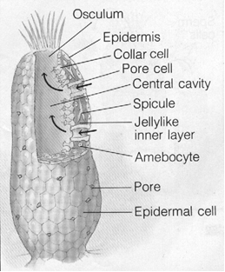
II. Form and Function in Sponges
B. The body of a sponge forms a wall around
a central cavity
The wall has thousands of pores
D. Collar cells: one of the cells forming the wall of a sponge’s central cavity

Slide 6
E. Osculum: large hole through which water exits the central cavity of a sponge
1.Functions of current of water that flows through the body of a sponge:
a. Delivers food to the cells
b. Delivers oxygen to the cells
c. Remove cellular waste products
d. Transports gametes or larvae out of the sponge’s body

Slide 7
F. Spicules: one of the thin, spiny structures that form the skeleton of a sponge
1. Built by amebocyte cells
2. 2 kinds:
a. Calcium carbonate (chalklike)
b. Silica (glasslike)
3. Soft(bath) sponges are composed of a protein called spongin

Slide 8
G. Describe how a sponge feeds:
Filter Feed ANIMATION
As the water moves through the sponge, tiny food particles stick to the collar cells. The trapped particles are then engulfed by the collar cells where they may be digested. If the collar cells do not digest the food, they pass it on to the amebocytes. When the amebocytes are finished digesting the food particles, they wander around, delivering digested food to other parts of the sponge. Digestion is intracellular (takes place inside cells).

Slide 9
H. How are the following accomplished in
Sponges (respiration, excretion and internal transport)?
-water flowing through a sponge will accomplish respiration, excretion, and internal transport

Slide 10
I. Reproduction
1. Sexual
a. Sperm is released into water flowing through the sponge and carried to the open water
b. Amebocytes pick up sperm and carries it to the sponge's eggs where fertilization occurs
c. Zygote develops into a larva that swims ; it is carried by currents before it settles down and grows into a new sponge

Slide 11
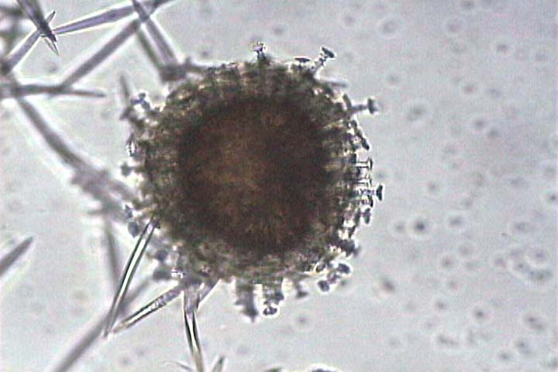
2. Asexual
a. Can produce structures called gemmules
b. These are sphere-shaped collections of amebocytes surrounded by a tough layer of spicules
c. Can survive long periods of
i. Freezing ii. Drought

Slide 12
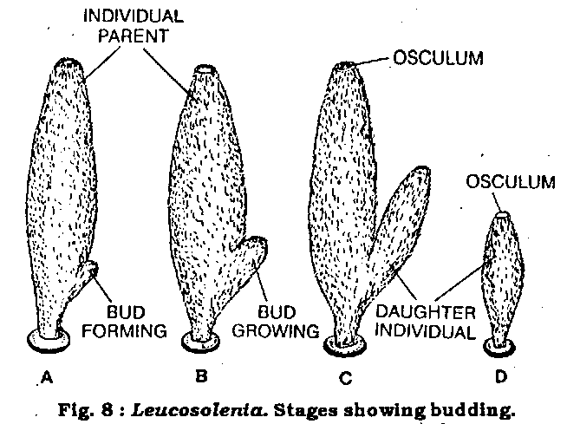
d. Can also reproduce by budding in which part of a sponge simply falls off the parent and grows into a new sponge

Slide 13
3. Regeneration
The ability to regrow a lost or damaged part
b. Separated sponge cells will clump together and grow into several new sponges

Slide 14
III.How Sponges Fit into the World
A. 6 things that sponges contribute:
1. Often live in dark places
2. Act as “homes” for: other marine animals
3. Live in symbiosis with: bacteria and protists
4. Boring sponges are important in “cleaning up” the ocean floor
5. Human uses:
a. Sponges in bathing
b. Protective chemicals may be
powerful toxins or act against predators

