Slide 1
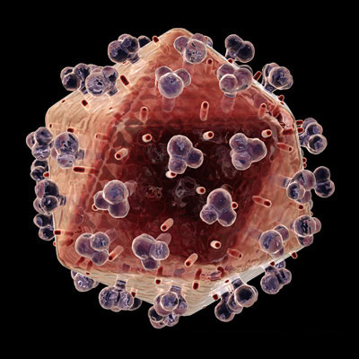
Ch. 17.1 Viruses
The name “virus” means poison in the Latin language

Slide 2
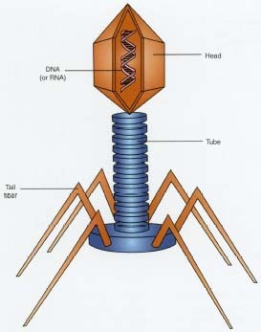
I. What is a Virus?
A.Virus: is a noncellular particle made up of genetic material and protein that can invade living cells

Slide 3
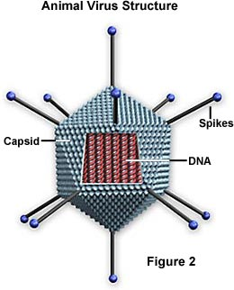
B. Structure of a Virus
1. CORE of nucleic acid
a. Made of DNA or RNA but never both
b. Contains up to several hundred
genes

Slide 4
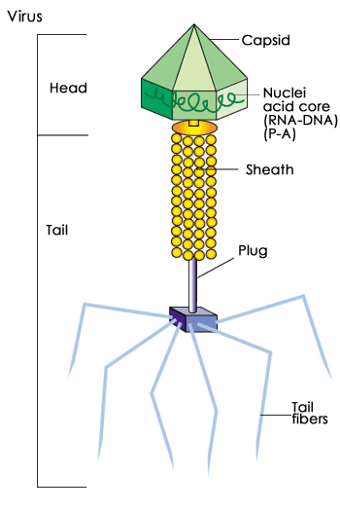
Because most viruses are extremely well adapted to their host organism, virus structure varies greatly.
All viruses have a capsid or head region that contains its genetic material
Some viruses, mostly those that infect bacteria, have a tail region. The tail is an often elaborate protein structure. It aids in binding to the surface of the host cell and in the introduction of virus genetic material to the host cell.

Slide 5
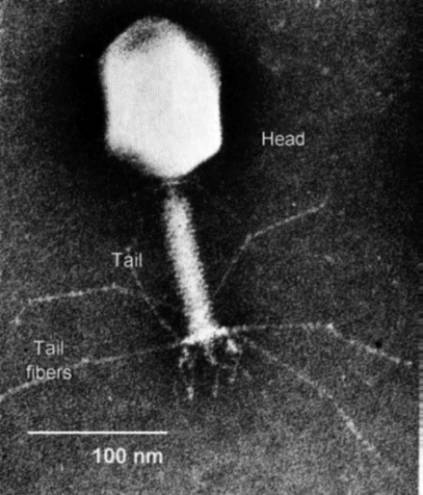
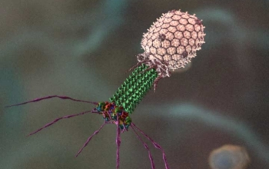
C. Bacteriophage:
are viruses that invade
bacteria

Slide 6
Some shapes of viruses:
Rod-shaped
Tadpole Shaped
Helical
Cube shaped
Viruses vary in size from approximately 20 to 400 nanometers.
1 metre(m)=1 000 000 000 nanometer(nm)

Slide 7
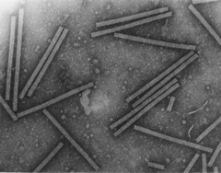
Specificity of a virus
1. What specificity means: specific viruses will infect specific organisms
a. Example: a plant virus cannot infect an animal
Tobacco Mosaic Virus

Slide 8
II. Life Cycle of a Lytic Virus
A. In order to reproduce, viruses must invade, or infect, a living host cell.
Animation

Slide 9
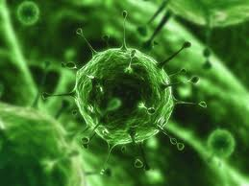
B. Infection:
1. Virus activated by chance contact with
right host cell
2. T4: tail attaches to the surface of a
bacterium
3. DNA is injected into the bacterium
VIRAL INFECTION

Slide 10
C. Growth:
1. Host cell cannot tell the difference
between its own DNA and the DNA of
the virus
2. Viral messenger RNA (mRNA) acts
like a molecular wrecking crew, taking over the infected host cell
3. Produces enzymes that destroy
host's own DNA but don’t harm the viral DNA!

Slide 11
D. Replication
Virus uses materials of the host cell to make thousands of copies of its own protein coat and DNA
Host cell becomes filled with hundreds of viral DNA molecules
3. This sequence (I,G,R) can take as little
as 25 minutes!
4. During final stages:
a. New virus particles are assembled
b. Infected cell lyses (bursts)
c. Hundreds of new virus particles are released and may now infect other cells
5. Called a lytic infection because the host cell is lysed and destroyed

Slide 12
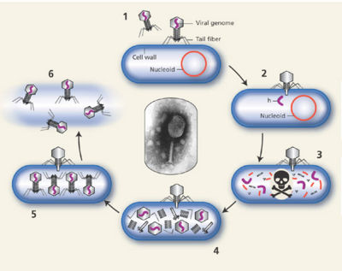
Lytic Cycle

Slide 13

III. Lysogenic Infections
A. How it differs from a lytic infection:
1. Viral DNA enters cells and is inserted Into the DNA of the host cell
2. Once there, called a prophage
3. May remain in host DNA for many generations
Click above image

Slide 14
Prophage activity:
May actually benefit the host cell by:
1. Blocking the entrance of other viruses
2. Adding useful DNA sequences
3. Doesn’t stay in prophage form forever; eventually DNA becomes active, and
removes itself from host DNA
4. Then it directs the synthesis of new virus particles
5. Factors that can activate the virus:
a. Sudden changes in temperature
b. Availability of nutrients

Slide 15
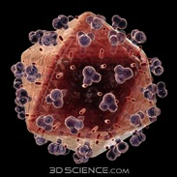
C. Retroviruses:
1. Contain RNA as their genetic material
2. When infecting a host, make a DNA copy of their RNA genes
3. This DNA acts like that of a lysogenic virus and is inserted into the host DNA
4. Name means “backward virus” and comes from their genes being copied
backward from RNA to DNA
5. AIDS is caused by a retrovirus called HIV

Slide 16
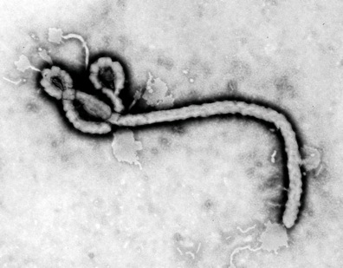
IV. Viruses and Living Cells
A.Viruses are parasites:
an organism that depends entirely upon another living organism for its existence in such a way that it harms that organism

Slide 17
Are viruses living or non-living?
Evidence for “non-living”:
- viruses cannot grow and develop independently
- viruses cannot reproduce independently
- viruses cannot obtain and use energy independently
2. Evidence for “living”:
        contains DNA

Slide 18
Origin of Viruses
A. More likely that viruses developed after living cells because they are completely
dependent upon living cells for growth and reproduction

Slide 19
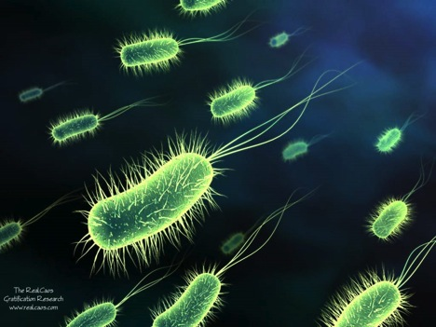
17-2: Monerans - Prokaryotic Cells
Monerans - Prokaryotic Cells
A. Prokaryotes: single-celled organism whose cells do not have a nucleus
They are found everywhere

Slide 20
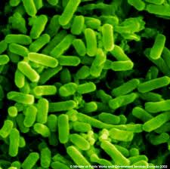
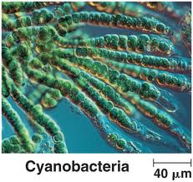
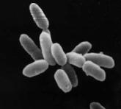
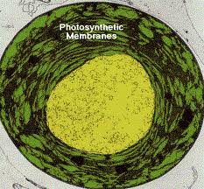
II. Classification of Monerans
A. All prokaryotes belong to the kingdom Monera
B. Divided into 4 Phyla:
1. Eubacteria
2. Cyanobacteria
3. Archaebacteria
4. Prochlorobacteria
E. C oli - Eubacteria
Archaebacteria
Prochlorobacteria

Slide 21
C. Bacteria: one-celled prokaryote; chiefly
parasitic or saprophytic
(saprophytic = lives on dead organic material)
1. Size: 1 to 10 micrometers
2. Smaller than eukaryotic cells because:
bacteria do not contain the complex range of membrane-enclosed organelles that are found in most eukaryotic cells

Slide 22
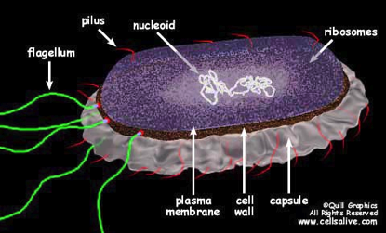
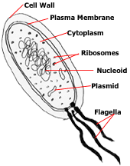
D. Eubacteria
1. Commonly called: bacteria
2. General appearance:
a. Cell wall composed of: complex carbohydrates
b. Within the cell wall is a cell membrane that surrounds the cytoplasm
c. Some have long whip- like flagella that protrude from cell membrane through the cell wall; these are used for movement.

Slide 23
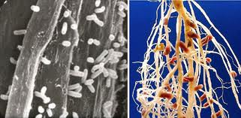
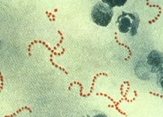
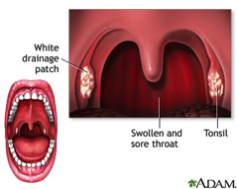
3. Lifestyles of bacteria include:
a. Live in the soil
eg: Rhizobia
b. Infect larger organisms and produce disease
eg: Streptococcus pyogenes
(causes Strep throat)
c. Photosynthetic

Slide 24
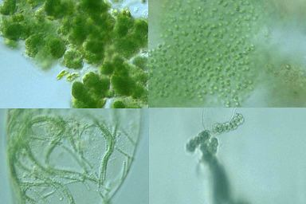
E. Cyanobacteria
Commonly called: blue-green bacteria
Origin of the name: are blue-green in colour
All cyanobacteria can carry out the reactions of photosynthesis

Slide 25
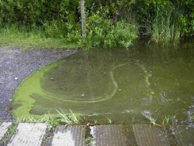
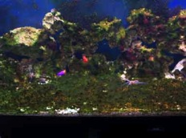
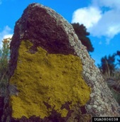
4. Habitat:
Fresh water
Salt water
Land

Slide 26
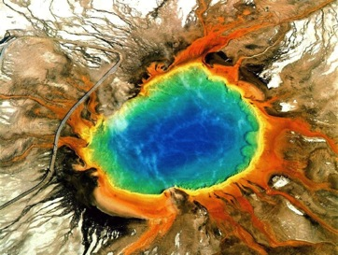
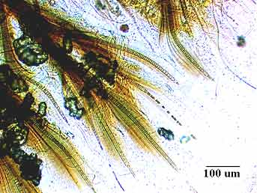
5. Some “extreme” habitats:
a. Hot springs b. Arctic
Tapered cyanobacteria filments
from Nunavut
The Grand Prismatic Hot Spring and its
famous thermophilic cyanobacteria

Slide 27
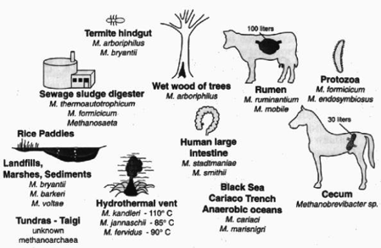
F. Archaebacteria
Habitat: extremely harsh environments
2. Methanogens:
a. Habitat: oxygen-free environments
  Examples: thick mud & animal digestive tracks

Slide 28
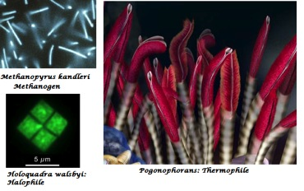
b. Origin of name: these bacteria produce methane gas
c. Other “extreme” habitats:
i. salty environments
  ii. extremely hot environments

Slide 29
III.Identifying Monerans
Name and sketch the basic shapes of bacteria:
Shape: | Name: | Sketch:
Rod | Bacilli
Sphere | Cocci
Spiral | Spirilla

Slide 30
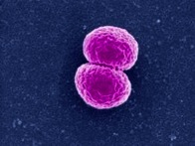
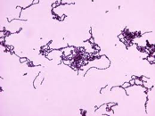
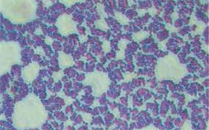
B. Sketch: 2 cocci together (diplococci):
Sketch: long chain of cocci
Sketch: a big clump of cocci:
Neisseria sp.
Streptococcus sp.
Staphlococcus sp.

Slide 31
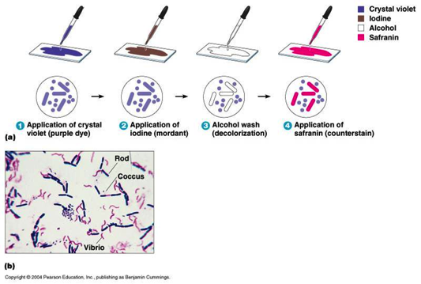
C. Cell wall
Gram Stain: Gram staining studies the chemical nature of the bacterial cell wall
Gram-positive bacteria have a thick mesh-like cell wall made of peptidoglycan (50-90% of cell wall), which stains purple while Gram-negative bacteria have a thinner layer (10% of cell wall), which stains pink.

Slide 32
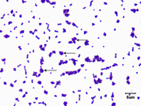
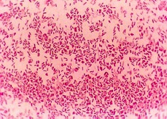
2. Gram-positive bacteria are coloured
purple because they take up the staincrystal violet
a. Their cell walls are made of: one
thick layer of carbohydrate and protein molecules
3. Gram-negative bacteria are coloured red because they take up the stain safranine
a. Their cell walls are made of: a second, outer layer of lipid and carbohydrate molecules

Slide 33
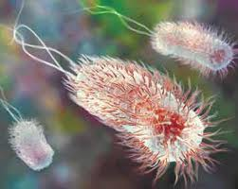
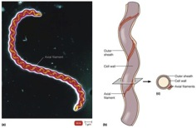
D. Types of bacterial movement:
propelled by one or more flagella
helical bacteria which have a specialized internal structure known as the axial filament
3. glide slowly along a layer of slime like
material that they secrete themselves
4. do not move ANIMATION

Slide 34
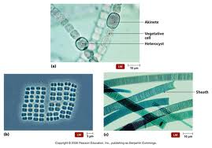
IV. How Monerans Obtain Energy
A. Autotrophs
1. Phototropic autotrophs: organisms that trap the energy of sunlight and convert it to organic nutrients
a. Example: cyanobacteria, eubacteria

Slide 35
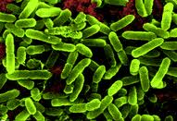
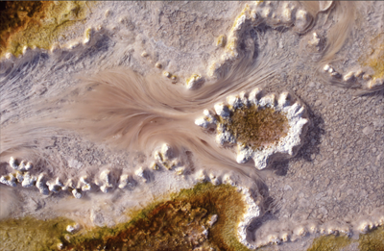
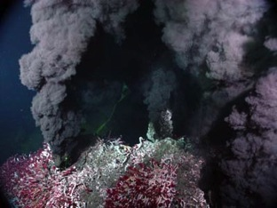
2. Chemotrophic autotrophs: organisms
that can obtain energy from inorganic molecules
a. Example inorganic molecules used:
hydrogen sulfide, nitrites, sulfur, and iron
Example: Nitrosomonas
(uses ammonia and oxygen)
The thin pink strands are bacteria
That use sulfides in hotsprings
Sulphur bacteria live in the hydrothermal vents off of H₂S

Slide 36
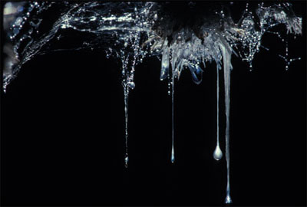
Snottites:
These colonies of single-celled bacteria hang from the walls and ceilings of caves. They are similar to small stalactites, but have the consistency of "snot," or mucous.
They feed on the sulfur-rich water that seeps into caves, and they live ensconced in a biofilm that protects them from the sulfuric acid in their environment. This acid is as strong as the acid found in car batteries

Slide 37
B. Heterotrophs
1. Chemotrophic heterotrophs: organisms that can obtain energy from organic molecules
Example: bacteria
2. Humans are also chemotrophic heterotrophs
a. Many bacteria compete with us for:
food sources
b. Example: Salmonella grows in raw meat, poultry, & eggs
c. If not properly cooked (to kill the
bacteria) they will “eat” this food and release poisons into it
d. This causes the illness we call food poisoning

Slide 38
V. Bacterial Respiration
A. Aerobic Respiration: process that involves oxygen and breaks down food molecules to release energy
B. Fermentation: process that enables cells
to carry out energy production in the
absence of oxygen (Anaerobic respiration)

Slide 39
Bacteria can be classes as:
C. Obligate aerobes: organisms that require
a constant supply of oxygen in order to live.
eg: Bacillus subtilis
D. Obligate anaerobes: organism that lives only in the absence of oxygen
Eg: Clostridium botulinum
E. Facultative anaerobes: organisms that
can survive with or without oxygen
eg: Staphlococcus, E. coli, Listeria

Slide 40
The Case of Clostridium botulinum (An obligate anaerobe)
1. Example organism: Clostridium
Botulinum
Often found in: soil
3. Causes no problems because it is
unable to grow in the presence of
oxygen, it normally causes very few problems
4. If it finds its way into a place free of air and filled with food material, they grow very quickly
A perfect place for them: canned food
6. They produce toxins that cause
“botulism”
7. These are deadly; they interfere with nerve activity, causing paralysis andsometimes death
8. Commercially canned goods are safe because: the bacteria and their toxins have been destroyed by heating the foods for a long time before the cans are sealed

Slide 41
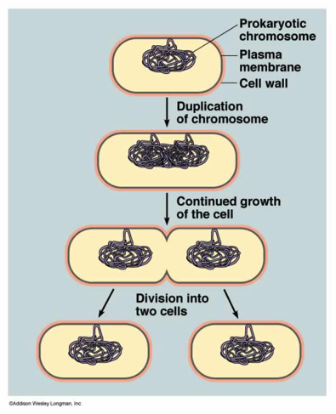
VI. Bacterial Growth and Reproduction
A. Bacterial growth is limited by:
1. space
2. food
B. Binary fission: type of asexual reproduction in which an organism
divides to produce two identical daughter cells

Slide 42
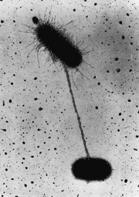
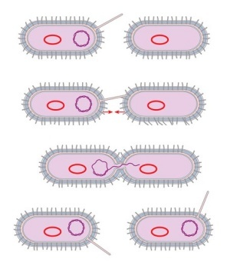
C. Conjugation
C. Conjugation: process in bacteria and
protists that involves an exchange of
genetic information
1. List the steps:
A long bridge of protein forms between and connects two bacteria
b. The genetic information from one cell (donor), is transferred to the other cell (recipient), through
this bridge
c. The recipient cell has a different set of genes
d. New combinations of genes
increase the genetic diversity in that
population of bacteria
2. Genetic diversity helps to ensure that even if the environment changes, a few bacteria may have the right
combinations of genes to survive

Slide 43
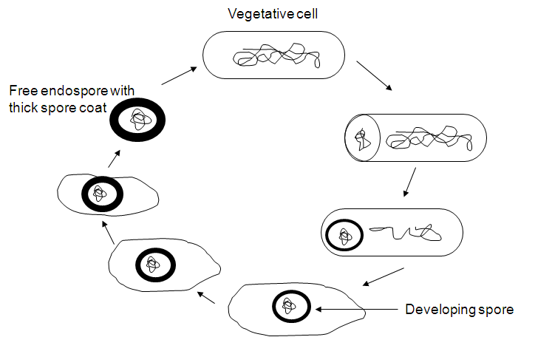
D. Spore formation:
1. An endospore is formed when conditions become unfavorable
2. Can remain dormant for months or even years
3. When conditions improve the endospore will open and the bacterium will begin to grow again

Slide 44
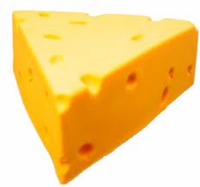
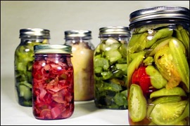
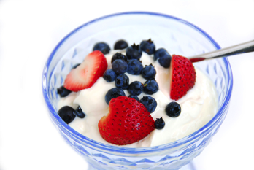
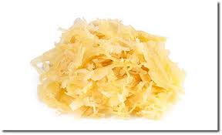
VI.Importance of Monerans
A. Bacteria are used to produce:
1. Cheese
2. Yogurt
3. Buttermilk
4. Sour cream
5. Pickles
Sauerkraut
Wine

Slide 45

B. Industrial uses of bacteria:
1. Cleaning up oil spills
2. Remove waste products and poisons
from water
3. Mine minerals from the ground
4. Synthesize drugs and chemicals

Slide 46
C. Symbiosis: close relationship between two species in which at least one species benefits from the other
1. Example: humans and E. coli:
a. Bacteria benefit by being provided with:
i. Warm safe home
ii. Plenty of food
iii. Free transportation
b. Humans benefit by getting:
i. Help in digesting our food
ii. Vitamins that we cannot produce
c. Cattle benefit by: having the bacteria in their intestines to produce enzymes necessary to break down cellulose, the principal carbohydrate in grass and hay

Slide 47
VII.Bacteria in the Environment
A. Nutrient flow: Bacteria recycle and
decompose, or break down, dead material
Winogradsky Column Streak Plate
1. Saprophytes: organism that uses the complex molecules of a once-living organism as its source of energy and nutrition
2. Other non-monerans that also help
the process: insects and fungi

Slide 48

B. Sewage decomposition:
1. Waste water contains: human waste, discarded food, organic garbage, and even chemical waste
2. Bacteria grow rapidly here and as they grow, they break down the complex compounds in the sewage into simpler compounds
3. This process produces: purified water, nitrogen gas and carbon dioxide gas, and leftover products that can be used as crop fertilizers

Slide 49
C. Nitrogen fixation:
1. All organisms on Earth are totally dependent on monerans for nitrogen
a. Green plants use it to make amino acids (building blocks for proteins)
b. Since animals eat plants, plant proteins is, ultimately, the ONLY source
2. Our atmosphere is 80 % N₂ gas – but living things need it in ammonia form
3. Cyanobacteria are the only organisms
capable of performing nitrogen fixation

Slide 50


4. Many plants have symbiotic relationships with nitrogen-fixing bacteria:
a. Example: soybean and Rhizobium, which invades and grows in root nodules
i. Bacteria get: home and a source of nutrients
ii. Plant gets: ammonia
iii. Nodules are built-in fertilizer factories
5. More than 170 million tons of nitrogen fixed every year

Slide 51




44-1:The Nature of Disease
Introduction
A. Disease: any change, other than an
injury, that interferes with the normal
functioning of the body
B. Infectious diseases are produced by
pathogens
Pathogens: are disease-causing
microorganisms such as viruses, bacteria, fungi, and protozoans

Slide 52
I. What is Disease?
A. Infection: when the body is successfully
invaded by a pathogen
1. The numbers of micro-organisms
around us is so large that infection is a daily event
2. Sickness is not a daily event because
not all infections produce disease
3. Infectious disease results only when the growth of a pathogen begins to injure the cells and tissues of an infected person

Slide 53
II. How is Infectious Disease Spread?
Pathogens require only opportunity to enter the body.
Examples:
Bacterium Clostridium tetani lives in soil and enters thru a cut or puncture in the skin
Common cold, measles, mumps, influenza spread thru coughing or sneezing
Others spread thru contaminated water supplies
Through food handled by an infected person
Spread by infected animals (e.g. ticks and mosquitoes)
- sexual contact

Slide 54

III. The Germ Theory of Infectious Disease
A. In the past is was believed disease was
caused by: evil spirits, magic or miasmas (vapors rising from marshes or decaying plant or animal matter)
B. People who became ill were thought to be
cursed or had bad luck

Slide 55

C. Germ Theory of Infectious Disease: idea
that infectious diseases are caused by
microorganisms

Slide 56


Koch's postulates:
Microbiologist Robert Koch was born in 1843. Koch's postulates are a series of ground rules to determine whether a given organism can cause a given disease. Koch theorized that:
1. The microorganism should always be
found in the body of the host organisms
and not in a healthy organism
2. The microorganisms must be isolated
and grown in a pure culture away from
the host.

Slide 57


3. When the microorganisms grown in pure culture are injected into a new host organism, they produce disease.
4. The same microorganisms should be reisolated from the second host and grown in a pure culture, after which the microorganisms should still be the same as the original microorganisms.

Slide 58

44-2 Agents of Disease
I. Introduction
A few micro-organisms find the human body an inviting home ANIMATION
  It is warm, protected, and full of nutrients
  Friendly ones settle in and live in certain parts of the body
Teacher note: These are called normal flora; our skin, mucus membranes, digestive system, etc. are host to billions; they actually help to keep us healthy by taking up niches that could otherwise be invaded by the pathogenic varieties!
Locations of Normal Flora

Slide 59
B. Some may invade and multiply in tissues,
or travel through the bloodstream
1. Unchecked, they may cause serious illness
C. Diseases are grouped according to the kind of pathogen that causes them

Slide 60
II. Viruses
A.Complete the following chart :
Disease | Organism that Causes the Disease | Methods of Spreading the Disease
Chicken Pox | one virus | droplets in air; direct contact with infected person
Common Cold | many viruses | droplets in air; direct contact with infected person
German Measles | one virus | droplets spread; direct contact with infected person
Influenza | two important types (A, B) of virus and many subtypes | direct contact with infected person; droplet infection; also may be airborne
Mumps | one virus | droplets spread; direct contact with infected person
Polio | three types of virus | direct contact with infected person

Slide 61

17-3: Diseases Caused by Monerans
II. Bacteria and Disease
A. Only a few types cause disease
B. Louis Pasteur was the 1st person to show
that bacteria cause disease

Slide 62
C. Some diseases caused by pathogenic
bacteria:
1. Diphtheria
2. Tuberculosis
3. Typhoid fever
4. Tetanus
5. Hansen disease
6. Syphilis
7. Cholera
8. Bubonic plague

Slide 63
D. Two ways in which bacteria cause
disease:
1. Damage cells/tissues of infected
organism by breaking down living cells for food
2. Release toxins that travel through body
& interfere with normal activity of host

Slide 64

E. Class rickettsias
Can only grow inside a living cell
Cause disease by method #1
3. Some diseases they cause:
a. Rocky Mountain spotted fever
b. Typhus
c. Q fever

Slide 65


F. Methods for fighting bacterial disease
1. Stimulating immune system through
vaccines
2. Antibiotics (def’n): a natural
compound that can destroy bacteria ANIMATION
Resistance

Slide 66


III.Controlling Bacteria
A. Sterilization: Destruction of living bacteria by exposure to great heat or chemical action
1. Heat: most can be killed in boiling water
Autoclaves are used to sterilize medical and laboratory equipment
2. Disinfectant (def’n): a chemical solution that kills bacteria

Slide 67



B. Food Processing
1. When bacteria “eat” our food, they cause it to spoil
2. Preventing spoilage:
a. Refrigeration: slows the growth of bacteria
b. Sterilization by cooking (e.g. boiling, frying, steaming)
c. Canning: sterilized food is sealed into glass or metal containers
d. Chemical treatments that inhibit bacterial growth in food:
i. salt (e.g. salted meat)
ii vinegar (e.g. pickled vegetables)
iii sugar (e.g. jam)

Slide 68
Your assignment:
Summarize the text into a good set of fill in the blank notes.
Summary Animation

